Slide 1
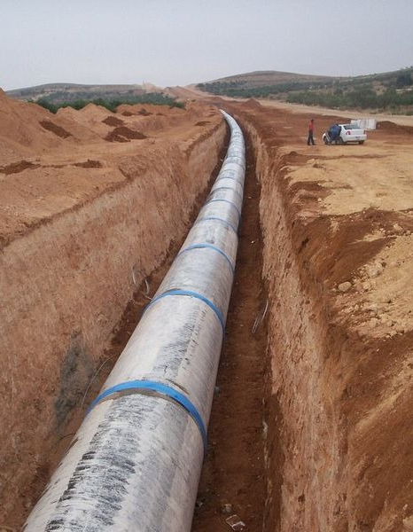
A numerical modeling technique designed for error insight
With application to 1D shallow-water flow simulations (rivers, channels, pipes, ...)
Mart Borsboom
Notes:
Thanks for the invitation.
Upon invitation by Barry Koren (professor at TUE, Dep.Math.&Comput.Sci.): some thinking about which subject to select (waves, GABC, DD, compatible discretization, …?). Because of renewed interest (SUPSUB H2I, Peter Wellens), compatible discretization and application to man-made river selected.
NB, ‘compatible’ and ‘compatibility’ are nowadays used in the numerical community to indicate (mimetic) schemes conserving certain properties at the discrete level, e.g., energy conservation. For this reason the developed discretization is now called ‘error-consistent’ (I still have to get used to that one ☺).
Invitation and hence preparing this presentation turns out to be a great opportunity to order and review a part of my review of the SUPSUB numerical implementation.
Citation from website: “The Centre for Analysis, Scientific computing and Applications (CASA) combines all activities related to analysis at the Department of Mathematics and Computer Science of Eindhoven University of Technology (TU/e).“

Slide 2
Contents
Examples of 1D shallow-water flow applications
The 1D shallow-water flow model equations
Computational model: the components
Numerical implementation: properties
Two-step numerical modeling approach
Finite volume method designed for error analysis
Test: flow over a weir (with grid adaptation)
Application: Libyan man-made river
Concluding remarks
What’s next
(this presentation and other info in \Bulletin\borsb_m\Adaptive-grid_SUPSUB)

Slide 3
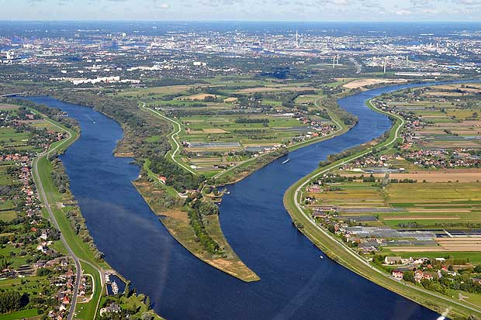
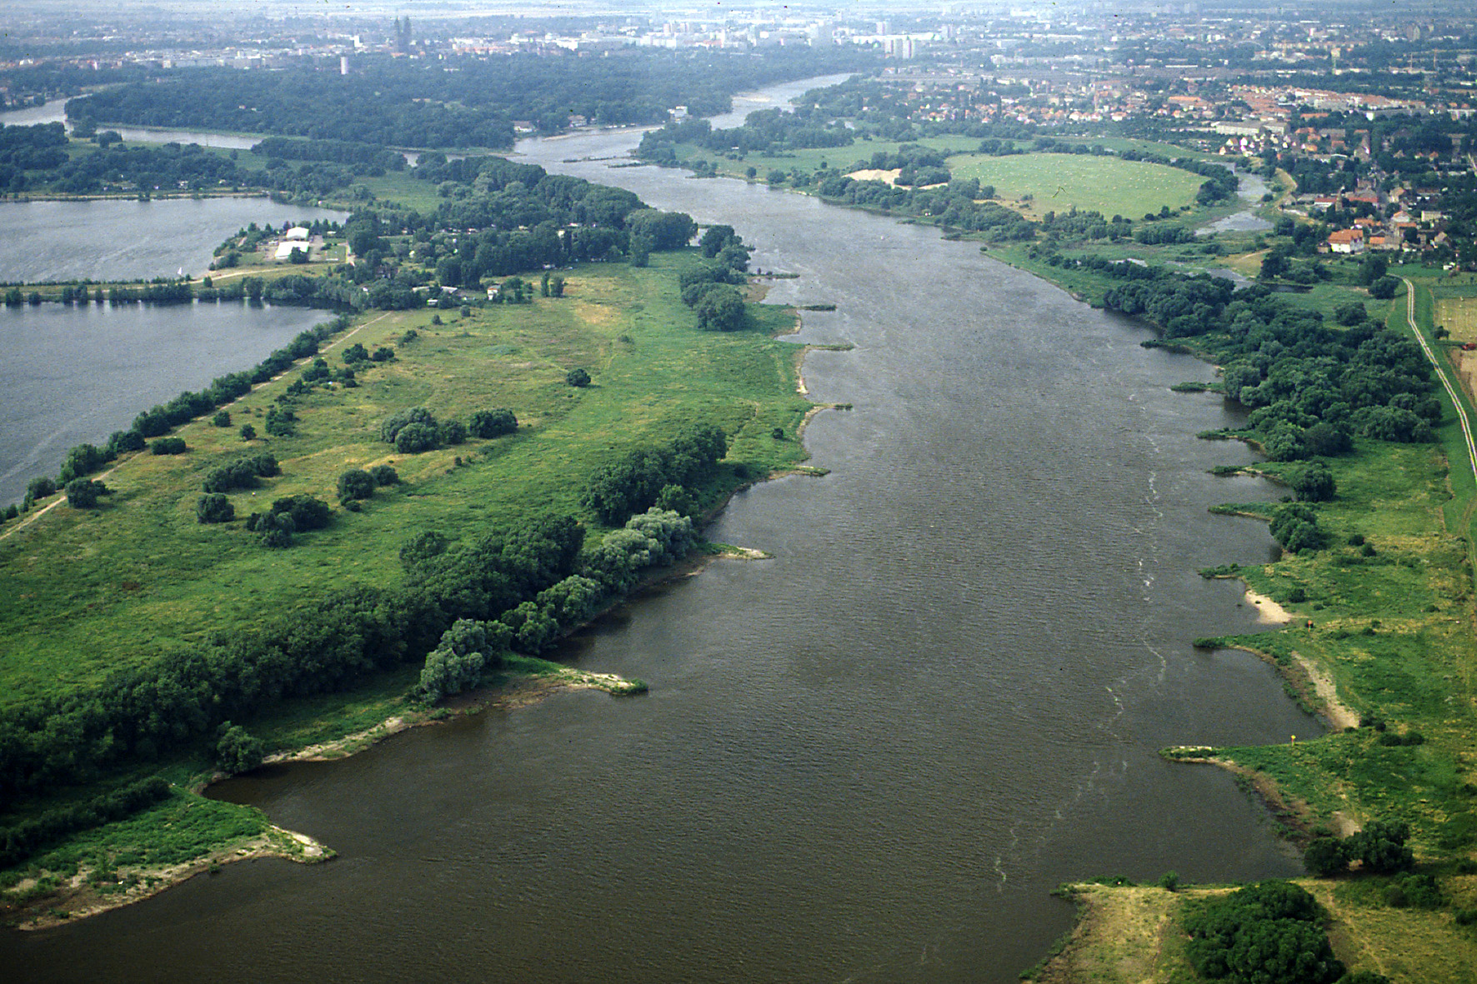
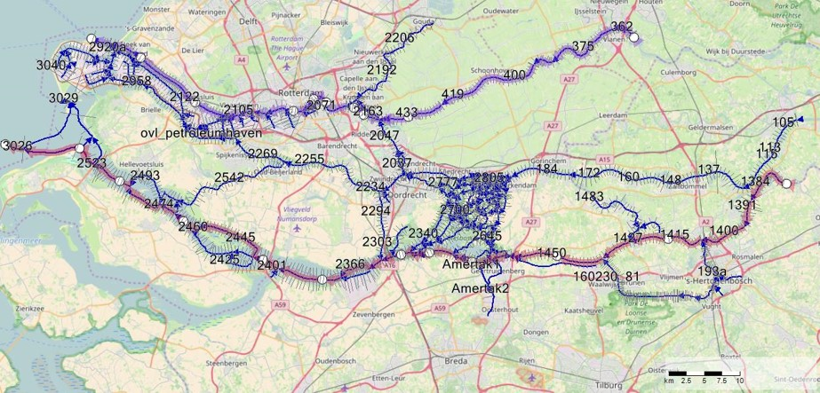
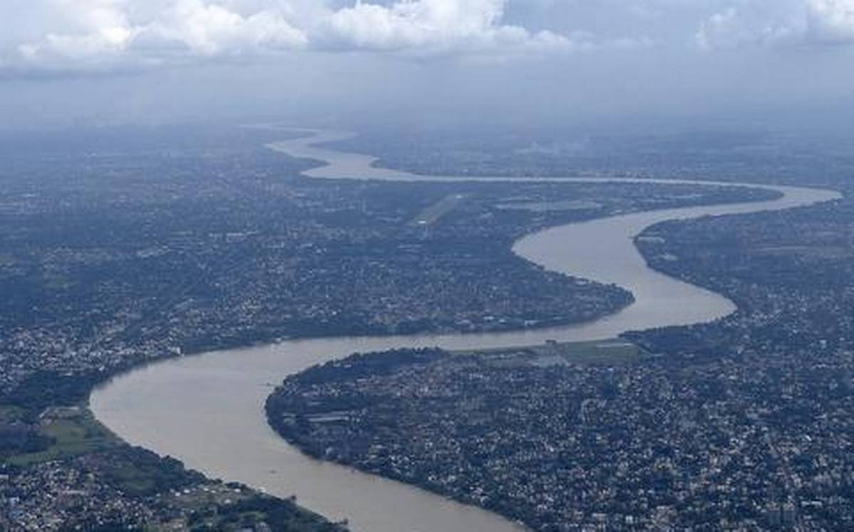
1D shallow-water flow applications

Slide 4
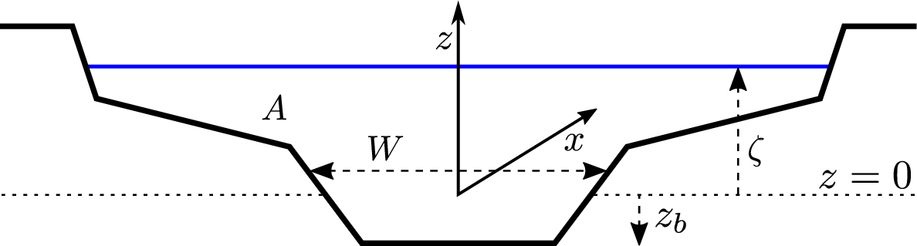
1D shallow-water equations
: channel width ( below bottom )
: free surface
: wetted cross-sectional area (→ effective depth )
: hydraulic radius (± average depth), with wetted perimeter
: discharge (→ average velocity )
Notes:
We don’t define A (and W, P) as a function of ζ, but ζ (and W, P) as a function of A, i.e., ζ=ζ(x,A) (and W=W(x,A), P=P(x,A)) with A=A(x,t) one of the two primitive unknowns. The other one is Q=Q(x,t). → Continuity equation is linear in the unknowns and always solved exactly, because free of linearization errors.

Slide 5
1D shallow-water equations
Constant channel width :
: depth
: depth-integrated velocity (→ average velocity )
5

Slide 6
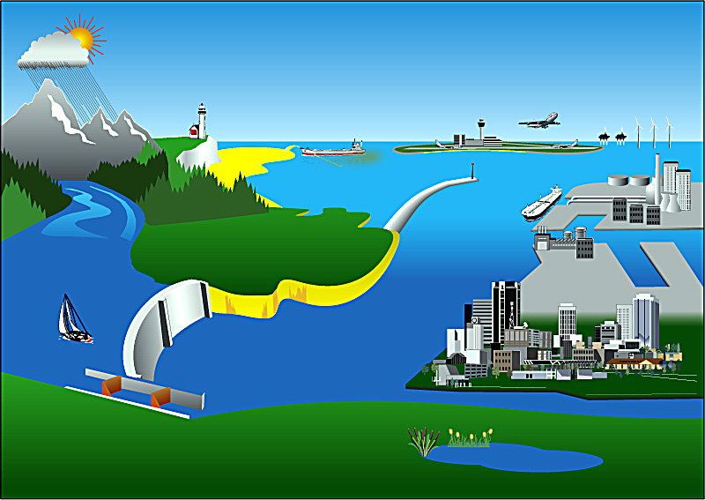





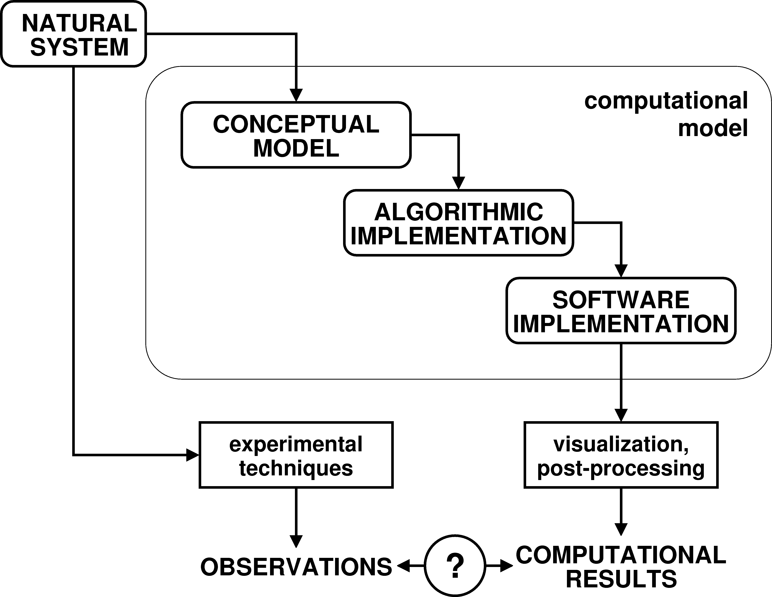



Computational model: the components
(plus user interface, grid generator, Kalman filter, …)
∂ζ / ∂t = …
this presentation is about the numerical implementation
Δζ / Δt = …
do i=1,nmmax
s1 = … enddo
Notes:
From Borsboom, “Domain Decomposition and (versus?) (Un)Structured Grids”, sep 2009 (dd&(un)struc.ppt), based on a figure taken from Borsboom, “A Finite Volume Method Designed for Error Analysis”, 1st Int. Symp. FVCA, Rouen, 1996. Note: controllers for, e.g., structures are part of conceptual model => implemented in algorithm and software, i.e., part of computational modeling.
NB, concept and nomenclature from Dee & Van Der Marel, “Validation of computer models–concepts and terminology”, WL report March 1991.
NB2, the hydrodynamic/shallow-water illustration/example of “natural system”, “conceptual model”, “algorithmic implementation” and “software implementation” taken from Mourits & Borsboom, “Flexibel, Efficiënt en Nauwkeurig Koppelen van Modellen—Taskforce Modulaire Code”, presentation DOSO meeting, December 2009.

Slide 7
Computational model: the numerical implementation
Properties that we are looking for:
accuracy
robustness
efficiency/parallelizability
flexibility/general applicability
user friendliness, ease of use (e.g., virtually no options)
relevance/fit for purpose
reusability, extendibility, modularity (esp. for developers and maintainers)
costs and risks (short-/long-term, in development/maintenance/applicability, ...)
ease of implementation
maintainability
ease of analysis
reliability (insight in modeling errors)
, traceability (what to do to improve results)
Notes:
user friendliness/ease of use also determined by user interface, pre-processing (including grid generation), post-processing, …
ease of analysis ←→ elegance
From Borsboom, “A finite volume method designed for error analysis”, presentation FVCA1 1996: … smoothness is essential for meaningful error analysis, cf. e.g. Yee, Sweby & Griffiths, JCP 1991: “… the application of the apparently straightforward numerical technique to genuinely nonlinear problems can be shown to lead to incorrect or misleading results.”

Slide 8

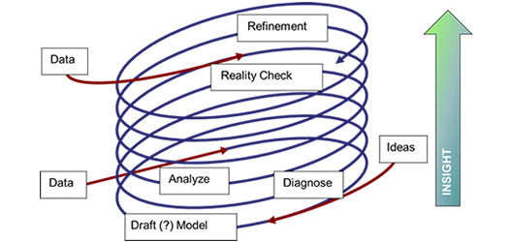







Computational Framework provides process support for model analyst
From presentation Peter Gijsbers
BlueEarth Engine (Computational Framework)
February 11, 2021
Intervention strategy
Scenarios
& Forcings
Reference model
Updated model(s)
Results
import
modify
execute
analyse
share
desktop application
powered by Delft-FEWS as a data model integration platform
8
Notes:
Sheet 6 from presentation Peter Gijsbers, BlueEarth Engine (Computational Framework), 11 February 2021
modeling-process.jpg

Slide 9
The basic idea
“… introduce (artificial) dissipative terms ... to give the shocks (MB: and other non-smooth features) a thickness ... somewhat larger than the spacing of the points of the network.”
“Then the difference equations may be used for the entire calculation, just as though there were no shocks (MB: and other non-smooth features) at all.”
“The quantitative influence of these terms can be made as small as one wishes by choice of a sufficiently fine mesh (MB: and a sufficiently small time step) …”
“… components whose wave-lengths are of order (MB: and whose time scales are of order ) are always falsified somewhat.”
(Von Neumann & Richtmyer, J. Appl. Phys. 1950)
(regularization à la LES)
(unified numerical implementation possible)
(basis for (automatic) grid adaptation
and time-step adaptation)
(dynamic subgrid effects can NOT be simulated!)
Notes:
ABSTRACT: “The equations of hydrodynamics (MB: and the data) are modified by the inclusion of additional terms which greatly simplify the procedures needed for stepwise numerical solution of the equations in problems involving shocks (MB: and other non-smooth features).”
ABSTRACT: “The quantitative influence of these terms can be made as small as one wishes by choice of a sufficiently fine mesh for the numerical integrations.”
I. INTRODUCTION: “We describe here a method for automatic treatment of shocks (MB: and other non-smooth features) which avoids the necessity for application of any such boundary conditions (MB: supplied by Rankine-Hugoniot equations). The approximations in it can be rendered as accurate as one wishes, by suitable choice of interval sizes and other parameters occurring in the method. It treats all shocks, correctly and automatically, whenever and wherever they may arise.”
I. INTRODUCTION: “The method utilizes the well-known effect on shocks of dissipative mechanisms, such as viscosity and heat conduction. When viscosity is taken into account, for example, the shocks are seen to be smeared out, so that the mathematical surfaces of discontinuity are replaced by thin layers in which pressure, density, temperature, etc. vary rapidly but continuously. Our idea is to introduce (artificial) dissipative terms into the equations so as to give the shocks (MB: and other non-smooth features) a thickness comparable to (but preferably somewhat larger than) the spacing of the points of the network. Then the differential equations (more accurately, the corresponding difference equations) may be used for the entire calculation, just as though there were no shocks at all.”
I. INTRODUCTION: “It will be seen that for the assumed form of dissipation (and, indeed, for many others as well), the Rankine-Hugoniot equations are satisfied, provided the thickness of the shock layers is small in comparison with other physically relevant dimensions of the system.”
I. INTRODUCTION: “The method has been applied, so far, only to one-dimensional flows, but appears to be equally suited to the study of more complicated flows; …”
III. THE EXPRESSION FOR Q: “The dissipation is introduced for purely mathematical reasons.” (MB: incorrect, should be: Smoothing is introduced to keep discretization errors small compared to smoothing errors.)
VII. STABILITY OF THE DIFFERENCE EQUATIONS: “… the long-wave-length components are accurately given by (48) to (51), provided Dx and Dt are sufficiently small, but the components whose wave-lengths are of order Dx are always falsified somewhat. This falsification is harmless, provided that all physically relevant components are treated accurately; this requires not only that Dx and Dt be small (MB: enough) but also that the physically insignificant components with wave-lengths of order Dx remain small during the entire calculation. It may happen not only that the short-wave-length components are falsified but also that their amplitudes increase with increasing n (MB: n is time-step index), in spite of the stability of the differential equations. This increase is generally exponential (MB: i.e., the result of numerically unstable behavior) and, if it occurs, quickly makes gibberish of the entire calculation (MB: obviously ☺).”

Slide 10
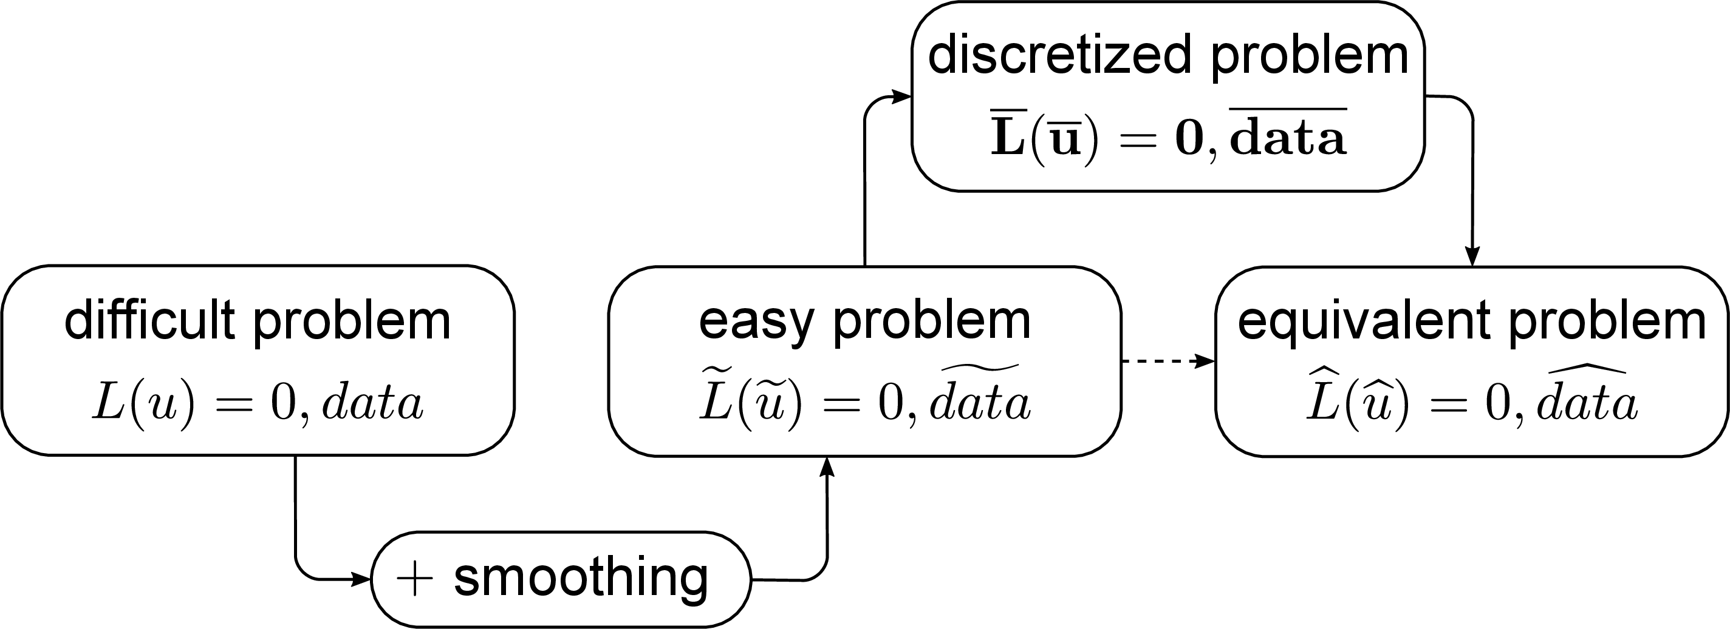
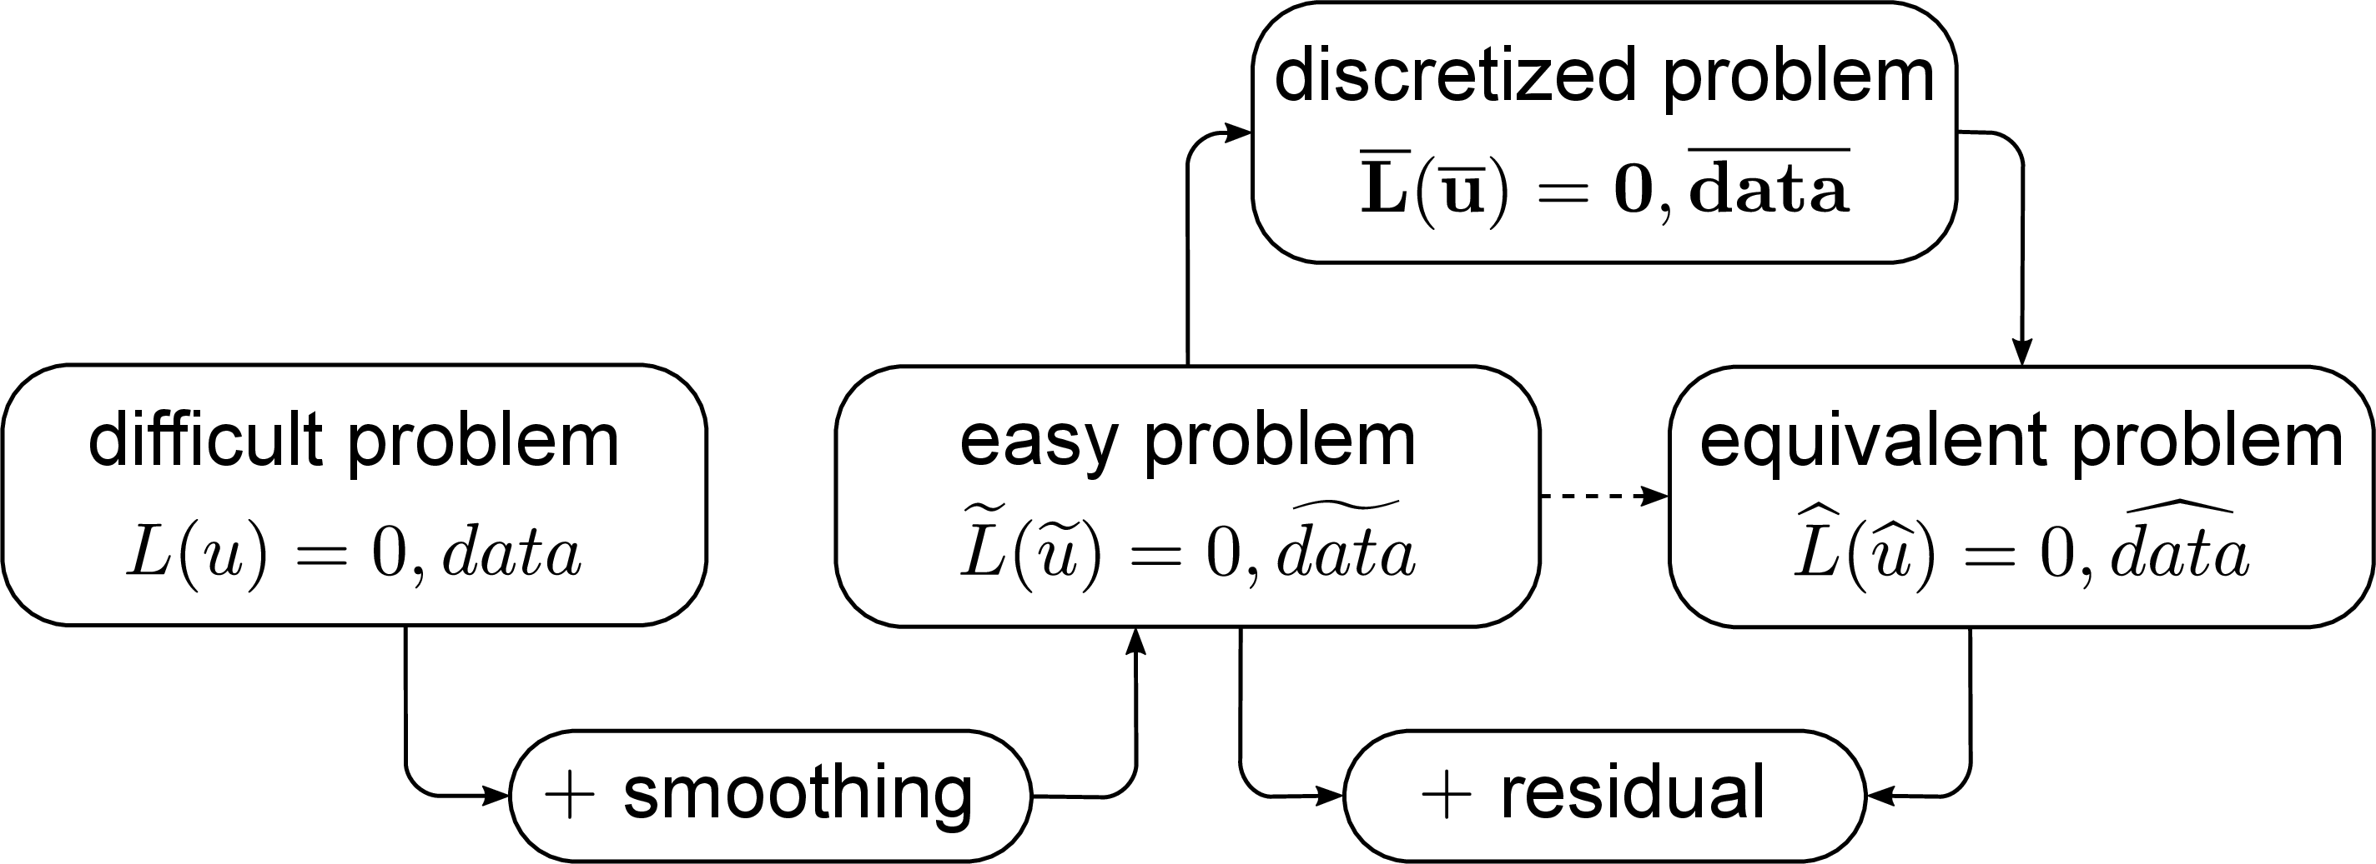
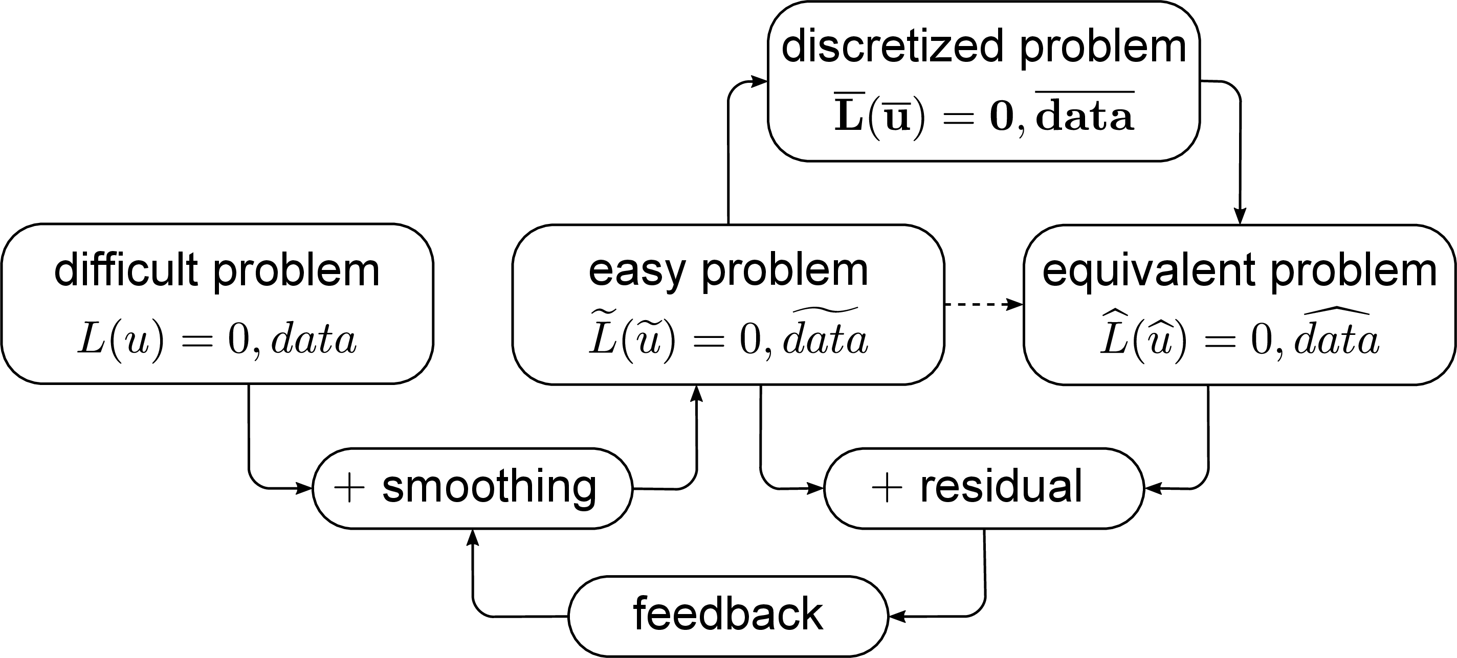
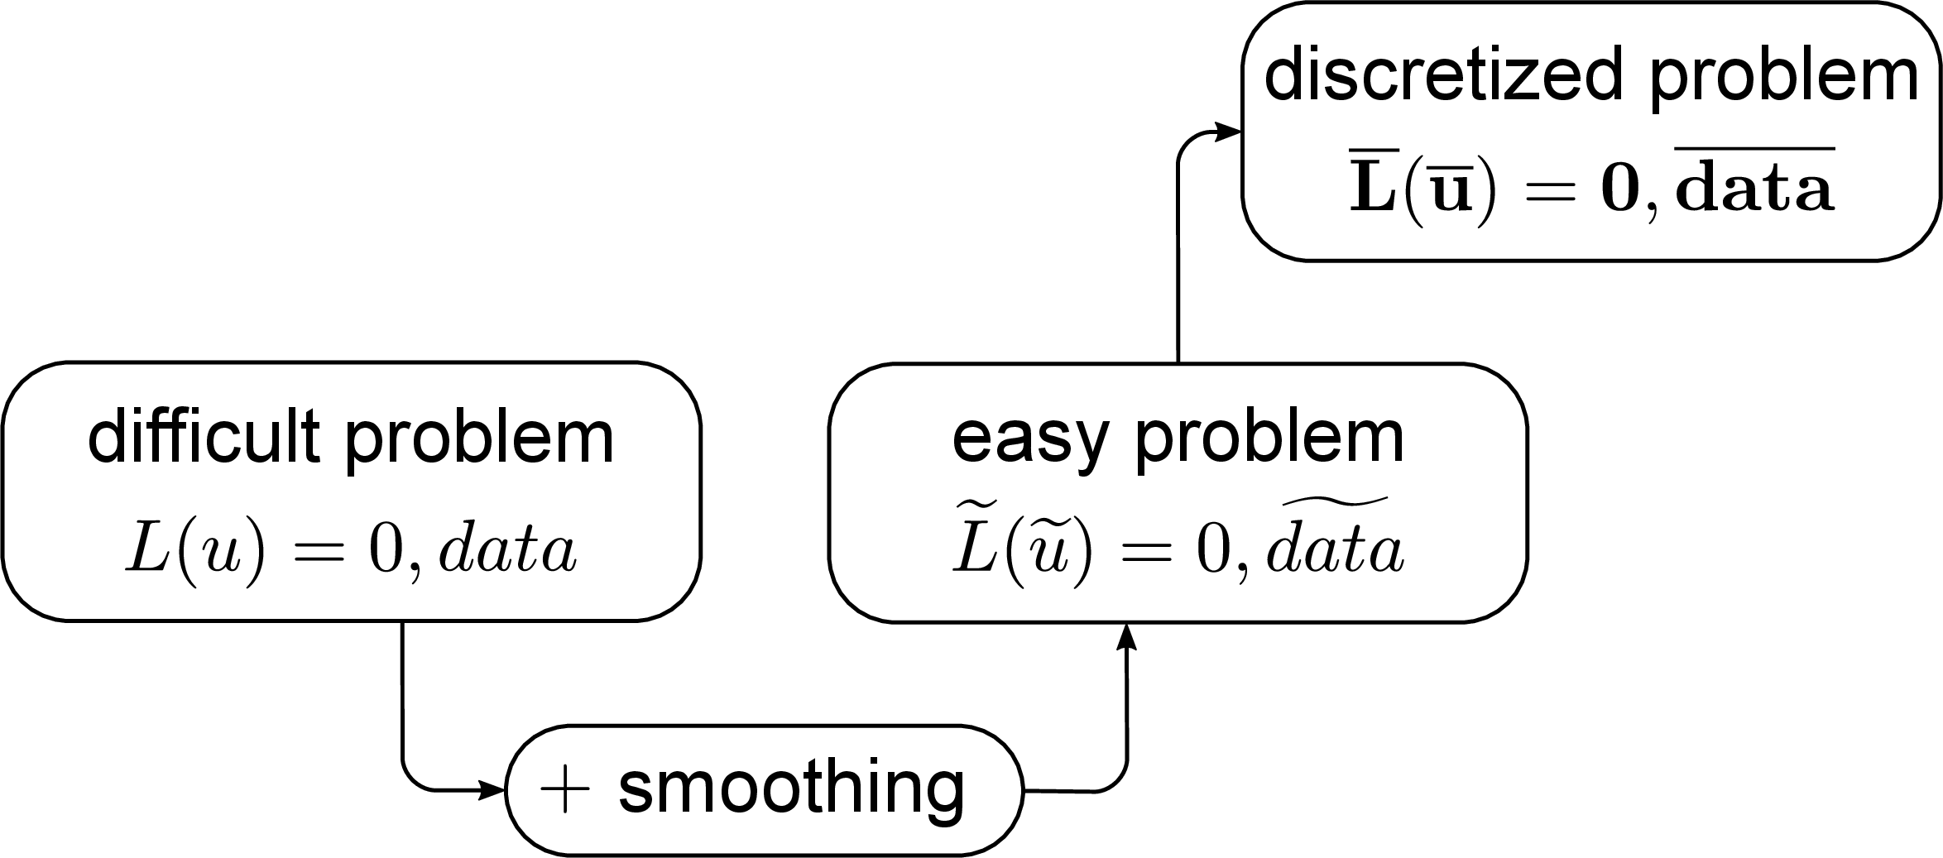
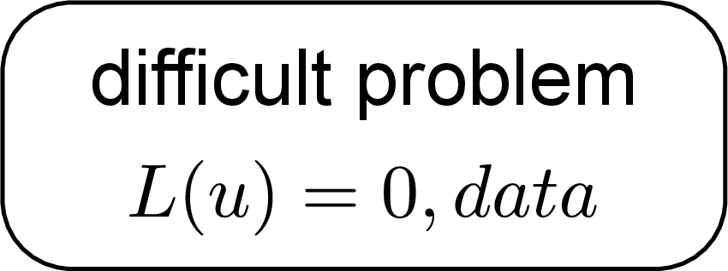
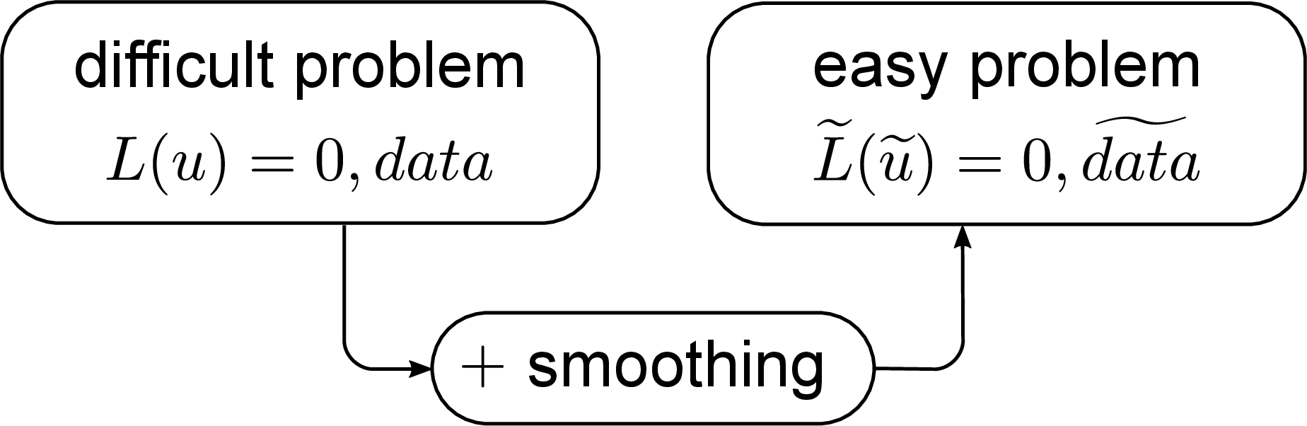
Two-step numerical modeling approach
ALGORITHMIC
IMPLEMENTATION
one-step numerical
modeling
CONCEPTUAL
MODEL
reduce/minimize by
means of (automatic)
grid adaptation and/or
time-step adaptation
regularization step
discretization step
Notes:
Application of regularization is well known, cf. (I)LES.
From Borsboom, “A finite volume method designed for error analysis”, presentation FVCA1 1996: … smoothness is essential for meaningful error analysis, cf. e.g. Yee, Sweby & Griffiths, JCP 1991: “… the application of the apparently straightforward numerical technique to genuinely nonlinear problems can be shown to lead to incorrect or misleading results.”
“(This indicates that) satisfactory design criteria do not exist at the present time that would ensure captured shocks that are both narrow and free from oscillations.” … “… some form of controlled shock spreading has been the cure recommended by several investigators.” Arora and Roe, 1997
“If one can approximate functions well, one can also solve PDEs well.” Djokovic and Van Damme, 1996

Slide 11
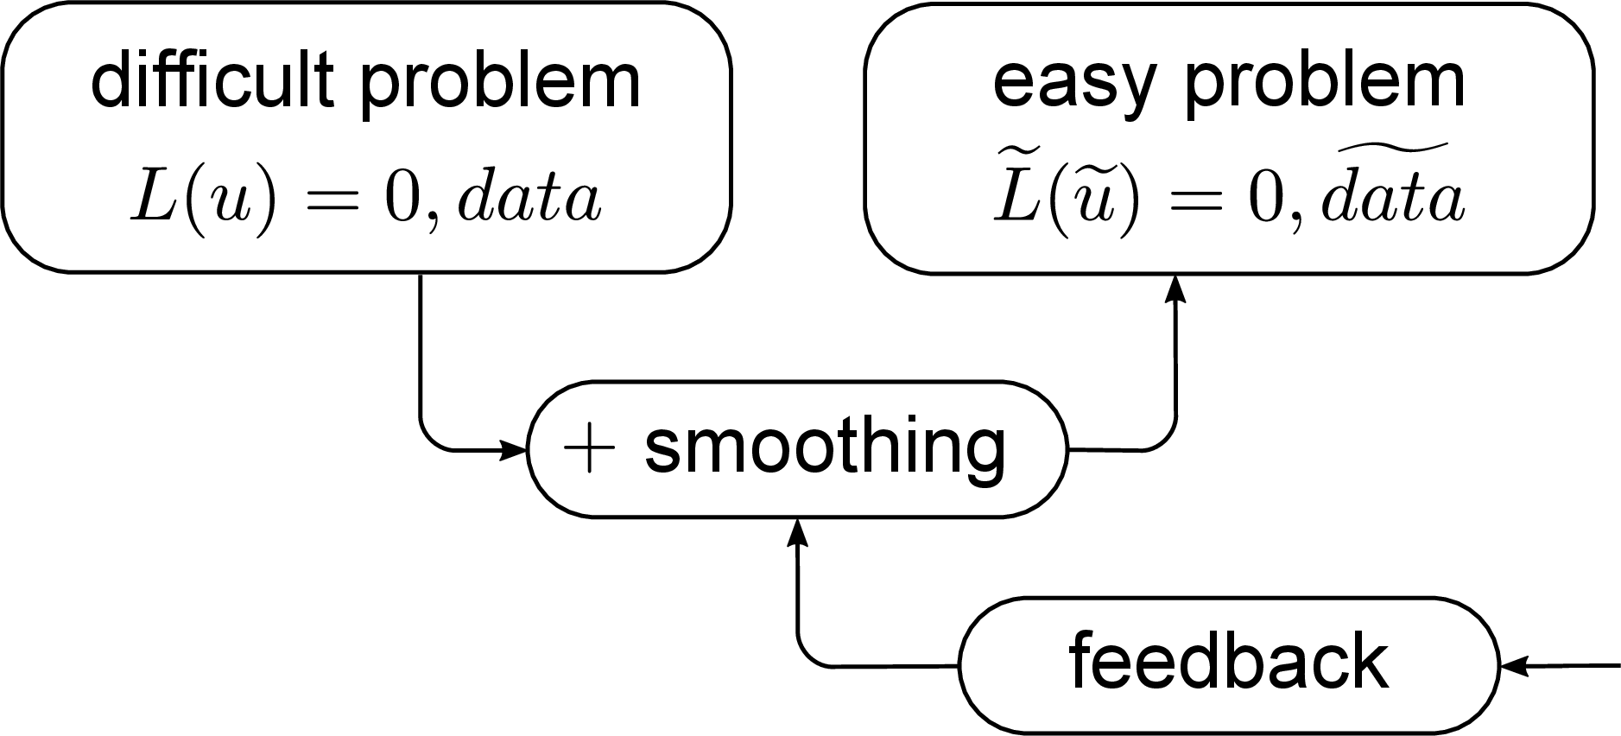
Difficult 1D shallow-water equations
Easy 1D shallow-water equations
regularization step
cont.eq. and mom.eq. combined to energy equation:
→ take
Notes:
Note: u~ is shorthand for Q~/A~

Slide 12
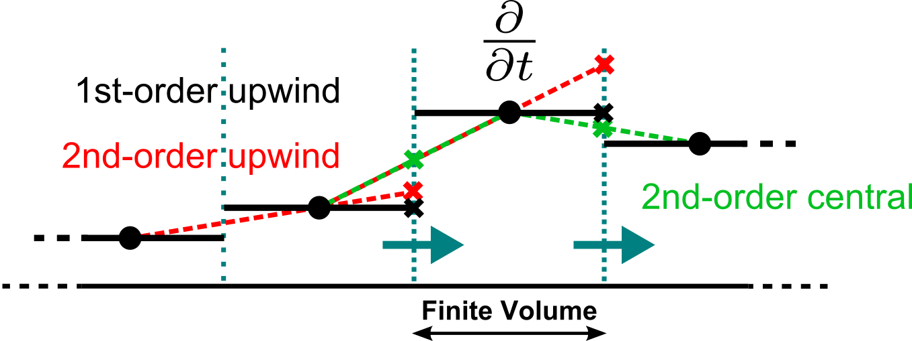
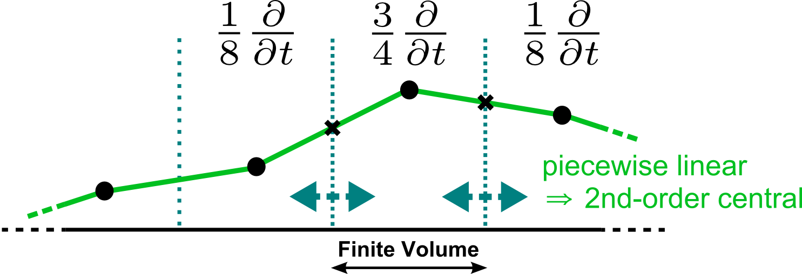
Finite volume-type collocated discretizations
finite difference-like
→ ± piecewise constant
finite element-like
piecewise linear
Notes:
Borsboom, “Compatibele schema’s voor stromings- en transportproblemen, de (vele!) voordelen en (slechts enkele?) nadelen”, WL memo 14 jan 1993, gepresenteerd/besproken in Thema 5 overleg van 20 jan 1993.
In Borsboom & Van Der Marel, Development of an adaptive grid procedure that compensates for discretisation errors, with an application to the 1D Burgers' equation, WL report Q1346, March 1992, no compatible discretization yet.
In Van De Langemheen, Simulation of 1-D open channel flow using a moving adaptive grid algorithm, WL report X125, November 1994, with a reference to Borsboom, M., Collected notes on: A compatible discretization and error-minimizing moving adaptive grid algorithm for one-dimensional convection-diffusion problems, July 1992--July 1994 (unpublished)
NB, in 2D piecewise (bi)linear finite element-like FV method possible on both triangles and quadrilaterals, but error analysis (cf. next slides) only possible on structured grid

Slide 13
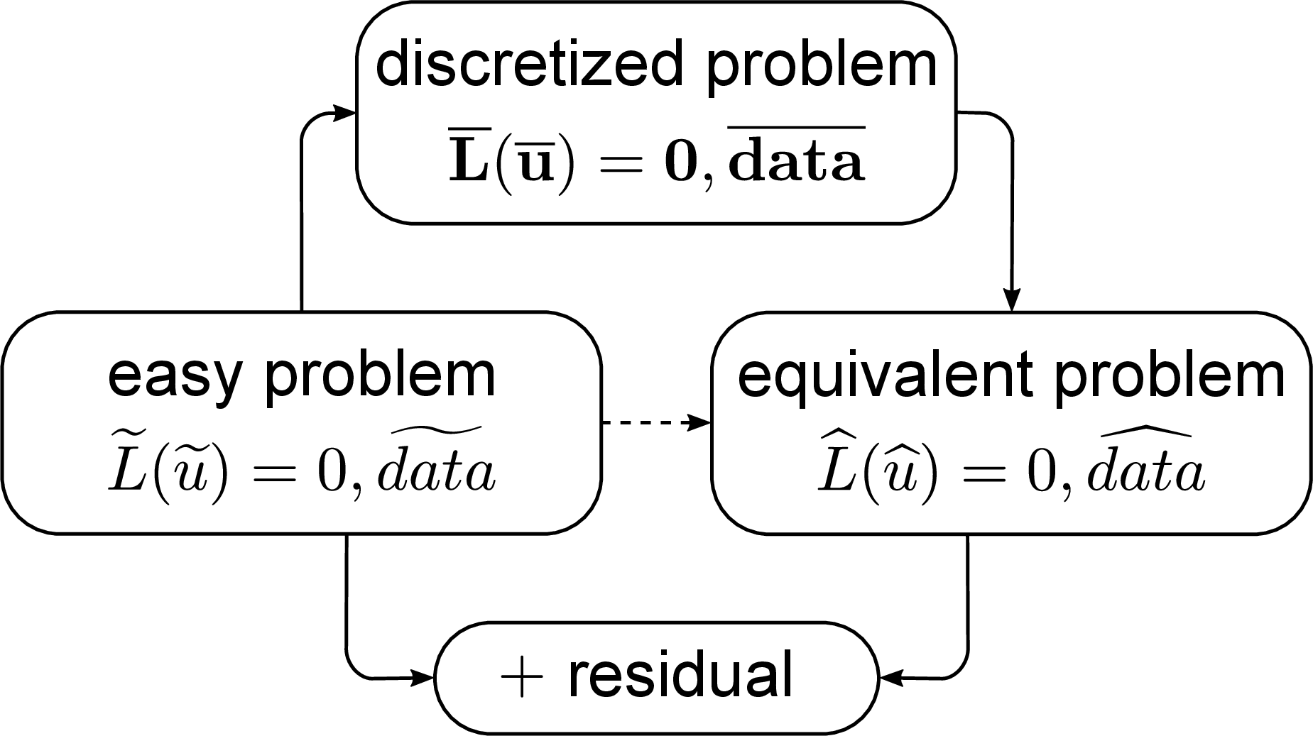
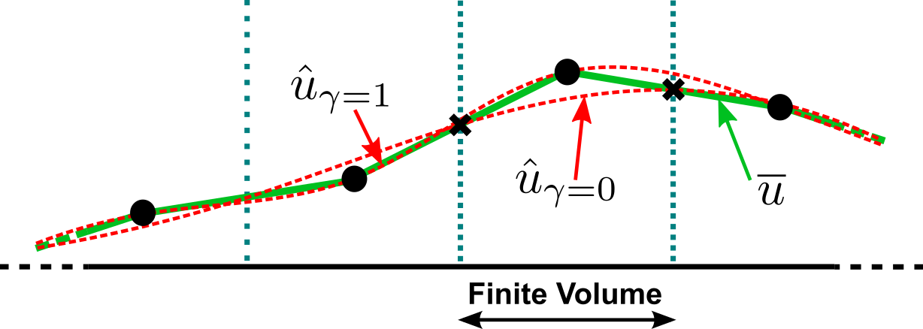
Error analysis
discretization step
Discretization error (residual)
We have
Hence
(Borsboom, Ch.5 in Adaptive Methods of Lines, 2001)
Notes:
Error analysis must be in computational space = only space where grid spacing is constant. → Coordinate transformation x(\xi) is also a function that is to be approximated smoothly! → This takes care automatically of sufficiently smooth grid.
2nd-order accurate determination of 2nd-order discretization errors → evaluation of integrals must be at least 4th-order accurate!
NOTE: with the exception of a uniform grid, \overline{x}(\xi) is NOT equal to \hat{x}(\xi)!

Slide 14
Equivalent 1D shallow-water-like equations
with , and with , , .
(Borsboom, Ch.5 in Adaptive Methods of Lines, 2001)
Notes:
Error analysis must be in computational space = only space where grid spacing is constant. → Coordinate transformation x(\xi) is also a function that is to be approximated smoothly! → This takes care automatically of sufficiently smooth grid.
2nd-order accurate determination of 2nd-order discretization errors → evaluation of integrals must be at least 4th-order accurate!
Piecewise linear in time/Crank-Nicolson → similar piecewise linear discretization errors in time.

Slide 15
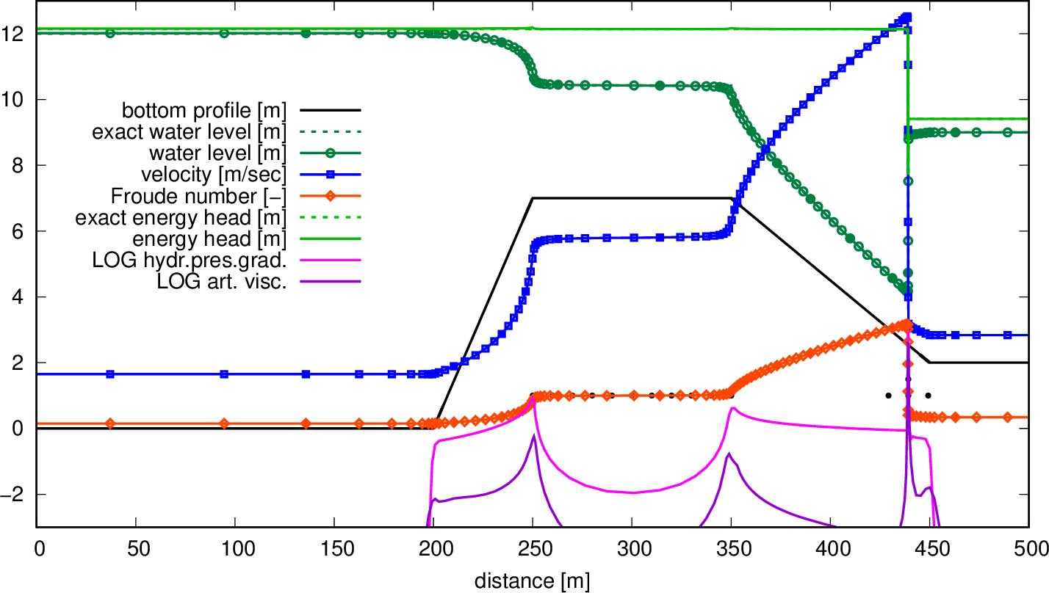
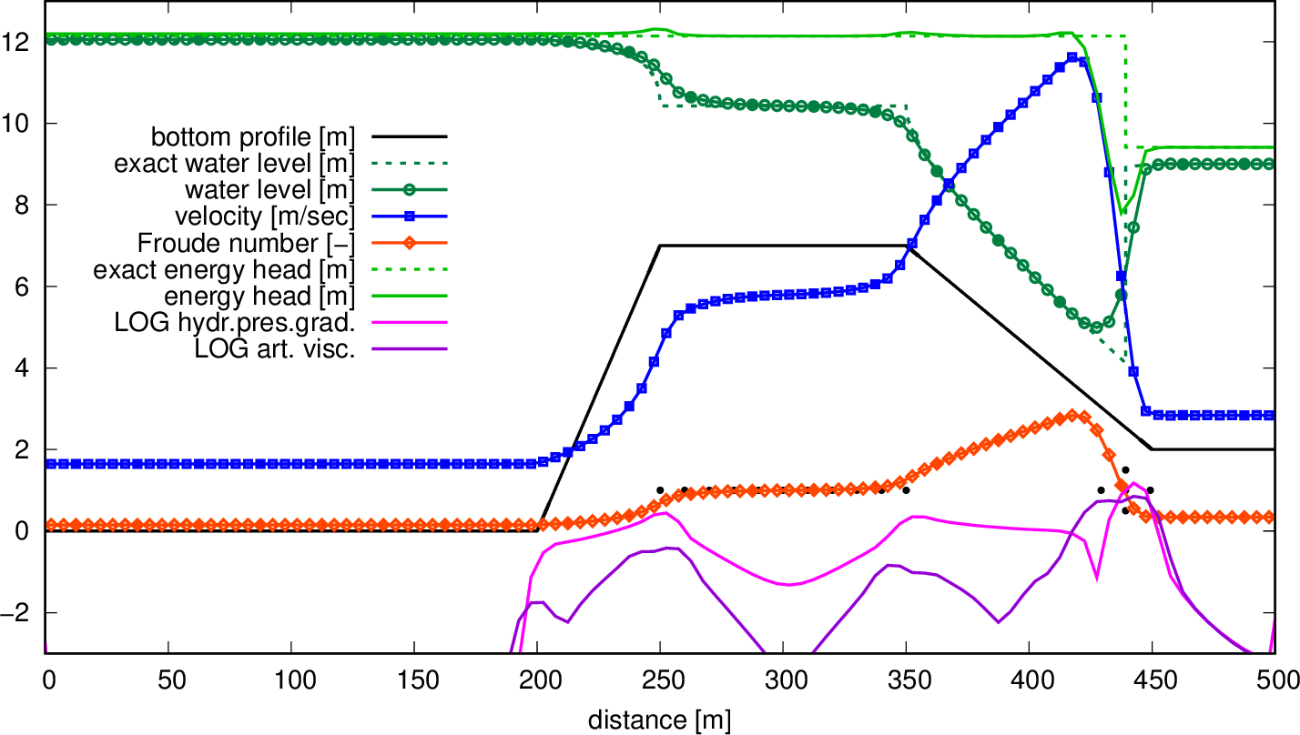
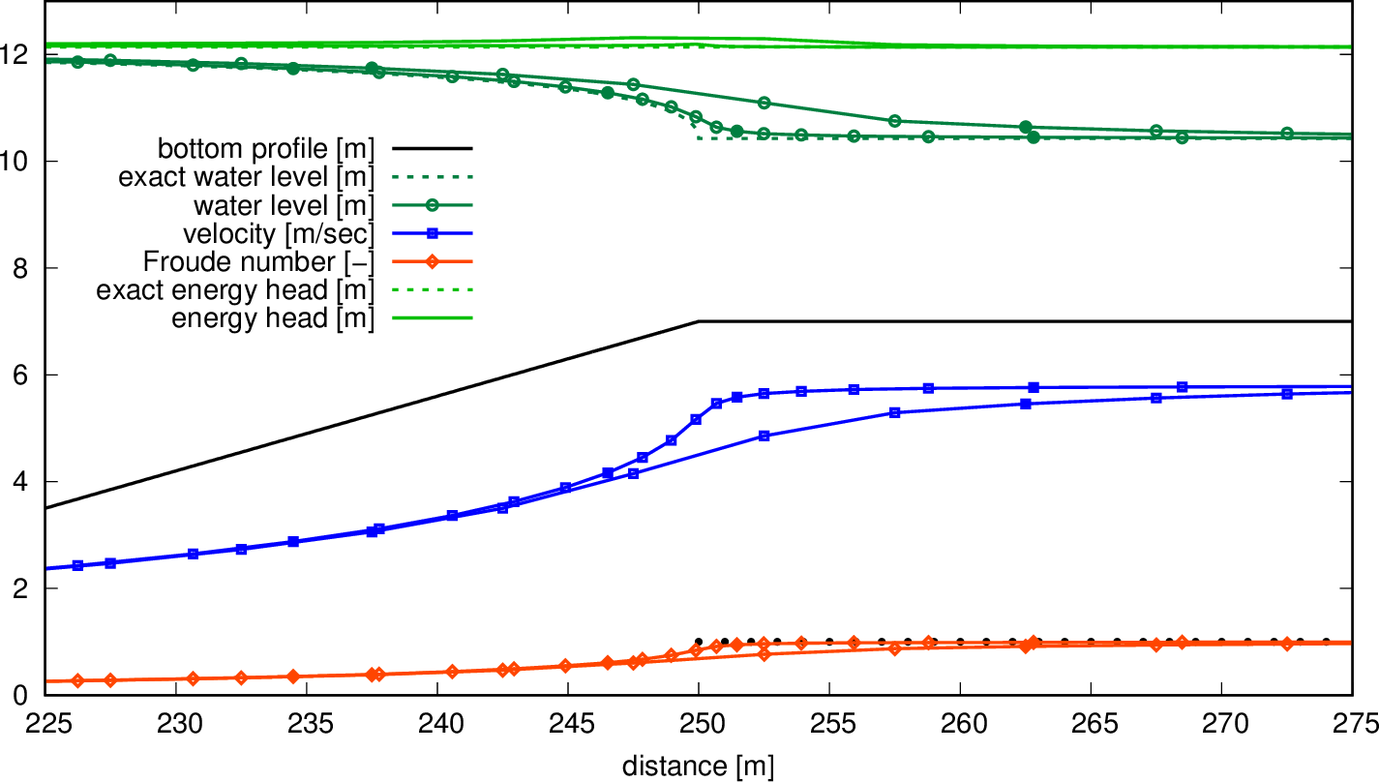
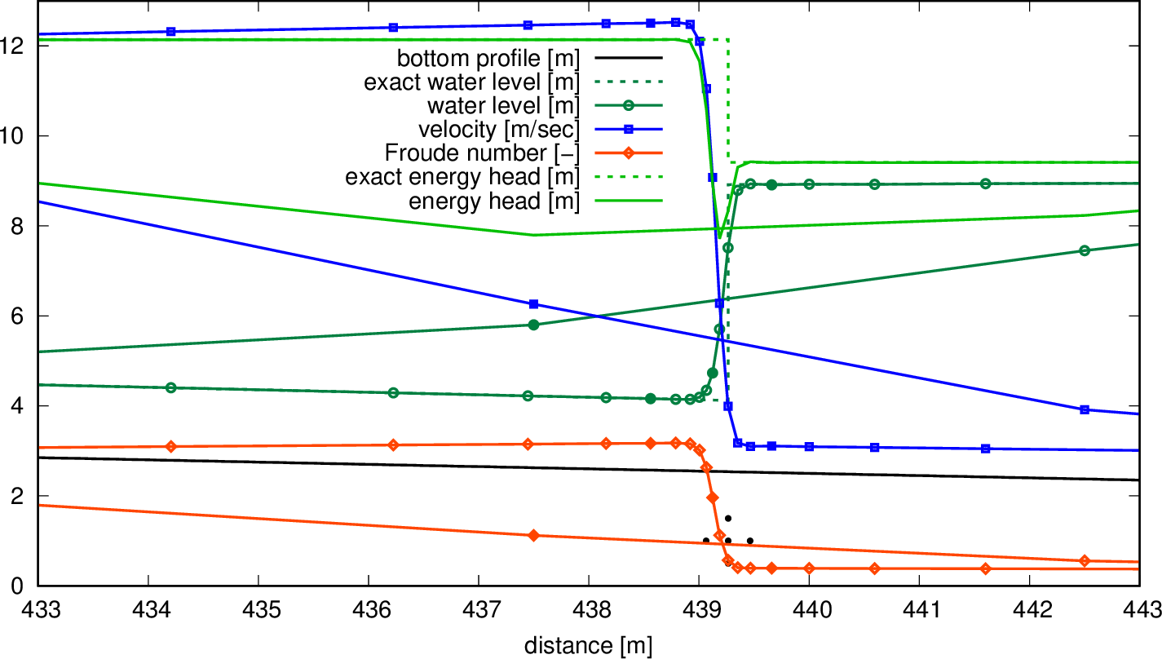
Sub-/supercritical steady flow over a weir
100 finite volumes, adaptive grid
100 finite volumes, uniform grid
100 finite volumes, uniform and adaptive grid, solution around jump
100 finite volumes, uniform and adaptive grid, solution near weir corner
Notes:
Grid size on uniform grid is 5m. Grid size on adapted grid:
at x = 0.0 largest Dx = 74.38m = 14.876 * 5m = 10^1.1725 * 5m
at x = 439.1 smallest Dx = 0.05960m = 0.01192 * 5m = 10^−1.924 * 5m
at x = 194.35 largest stretching of 0.567697 = 1/1.761503 = 10^-0.2459 = e^-0.5662
at x = 438.56 largest stretching of 0.562935 = 1/1.776404 = 10^-0.2495 = e^-0.5746
at x = 439.66 largest stretching of 1.768792 = 1/0.565358 = 10^0.2477 = e^0.5703

Slide 16
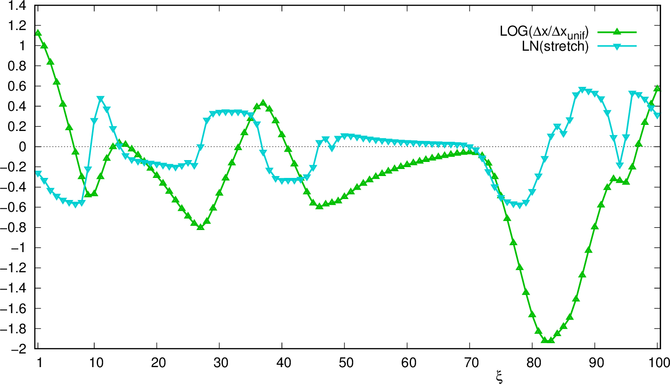
Sub-/supercritical steady flow over a weir
100 finite volumes, adaptive grid, grid size and grid stretching
16

Slide 17
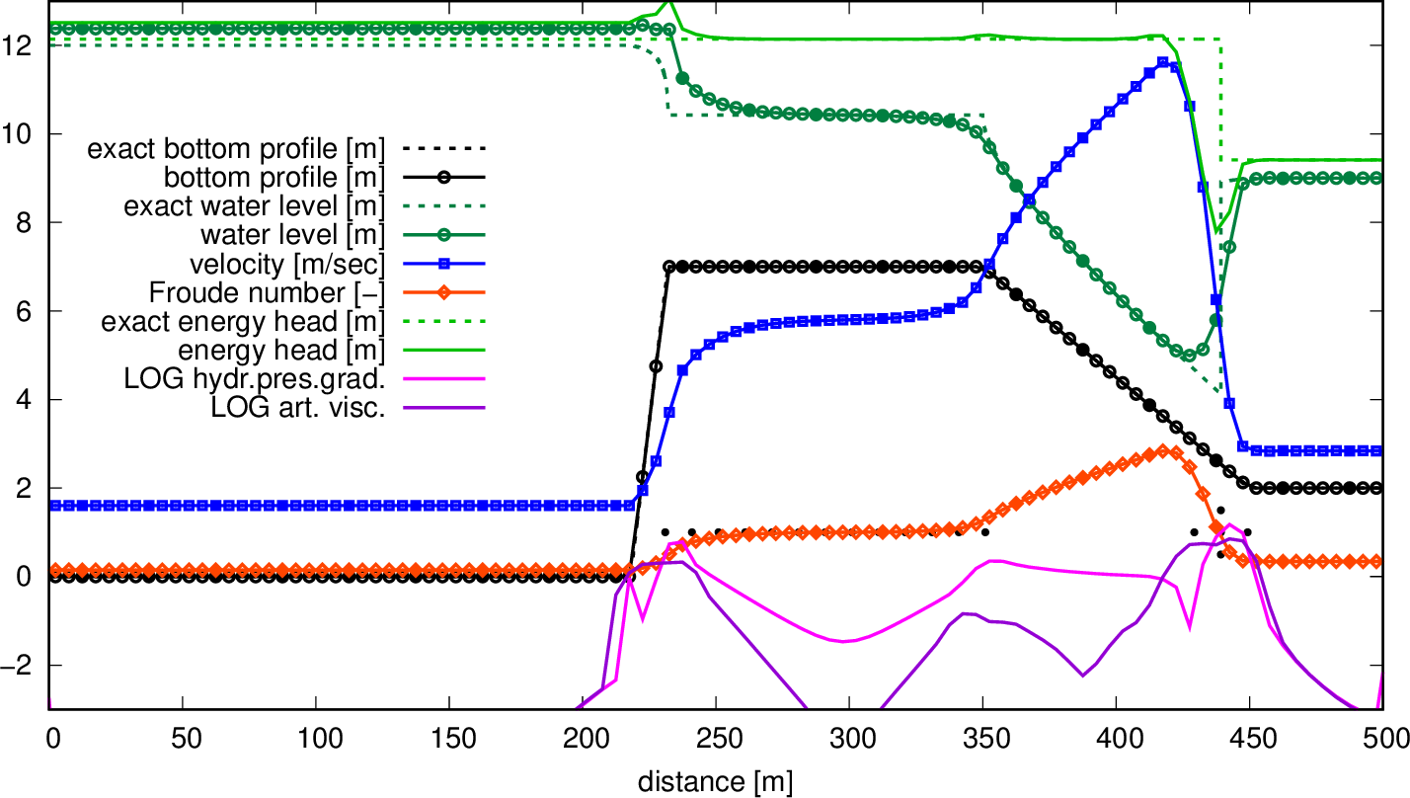

Sub-/supercritical steady flow over a weir
100 finite volumes, non-smooth geometry
100 finite volumes, smoothed geometry
Notes:
Number of iterations & comput.time in 2002 to reach both 10^-11 water-level conv.error and 10^-13 velocity conv.error
025FV, non-smooth/smoothed geom.: 32 & 0.06sec/30 & 0.05sec
050FV, non-smooth/smoothed geom.: 31 & 0.05sec/31 & 0.05sec
100FV, non-smooth/smoothed geom.: 39 & 0.11sec/39 & 0.11sec
200FV, non-smooth/smoothed geom.: 65 & 0.28sec/66 & 0.22sec
400FV, non-smooth/smoothed geom.: 78 & 0.61sec/78 & 0.55sec

Slide 18
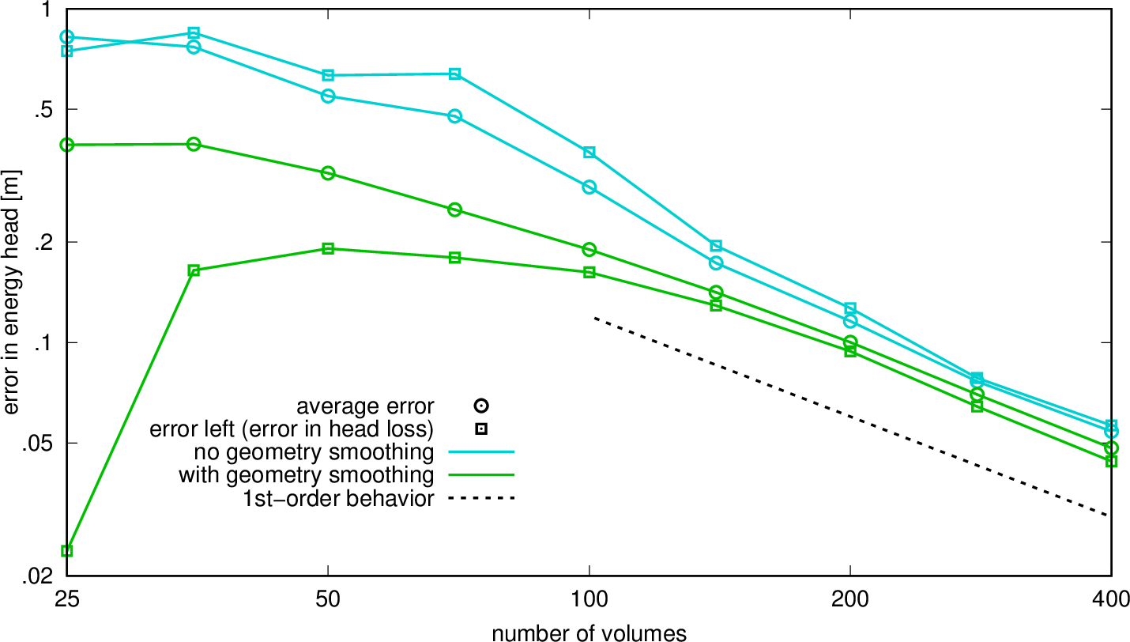
Sub-/supercritical steady flow over a weir
100 finite volumes, error on non-smooth and smoothed geometry
Notes:
Number of iterations & comput.time in 2002 to reach both 10^-11 water-level conv.error and 10^-13 velocity conv.error
025FV, non-smooth/smoothed geom.: 32 & 0.06sec/30 & 0.05sec
050FV, non-smooth/smoothed geom.: 31 & 0.05sec/31 & 0.05sec
100FV, non-smooth/smoothed geom.: 39 & 0.11sec/39 & 0.11sec
200FV, non-smooth/smoothed geom.: 65 & 0.28sec/66 & 0.22sec
400FV, non-smooth/smoothed geom.: 78 & 0.61sec/78 & 0.55sec

Slide 19
Solution method
Fully implicit time integration (for steady state set and )
Newton linearization
Stabilization/regularization
Notes:
Advantage of delta form: assuming convergence, process will converge to correct solution (determined by vanishing rhs) regardless of convergence process, i.e., regardless of whatever approximations and tricks are applied in lhs (“separate the numerics from the physics”). In particular, the pseudo-time step mass matrix M_pseu can be used to introduce (stabilizing?) Du upwind and/or (stabilizing?) Du smoothing in pseudo time and/or any other measure that improves convergence speed and/or robustness/stability.
Another advantage of delta form: less sensitive to round-off errors.
Best initialization of convergence process per steady state is u^{m=0} = 0 and zeta^{m=0} = constant and large enough, i.e., still-water flow in a fully filled model. This is a solution that is guaranteed to satisfy the discrete equations inside the domain, i.e., is guaranteed to be sufficiently smooth. To maintain this, do NOT apply the boundary conditions at once, but turn them on slowly, preferably by using convergence-error-dependent underrelaxation that turns itself off automatically upon reaching convergence (this is how it is done in SUPSUB).
Simplest initialization of convergence process per time step is u^n,0 = u^n-1. However, much better is to initialize this process by some estimation of u^n based on, e.g., some extrapolation in time or obtained from application of some explicit time integration scheme, e.g., leapfrog (not yet in SUPSUB).
Criterion for meaningful Newton linearization: requires sufficiently smooth L(u)!!!
Optimization of approximation of Jacobian as well as optimization of Dt_pseu required.
NB, space-varying 1/Dtvec_pseu per iteration. It is generally very advantageous to use a (locally optimized) Dt_pseu that varies in space and over the iterations.

Slide 20
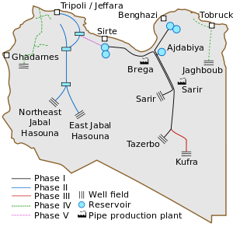
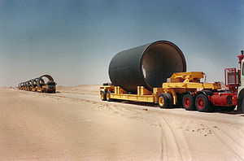
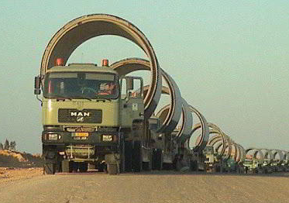
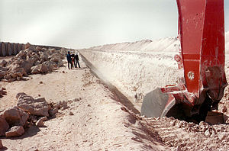
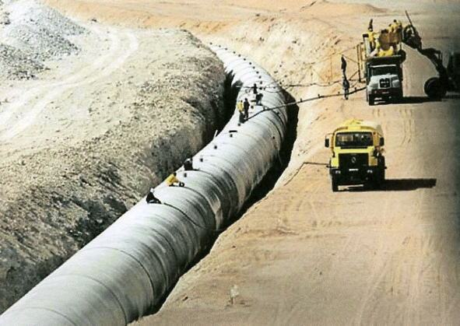
The great man-made river
Notes:
Michiel Tukker, HOPS presentation “Free surface flow in Wanda”, April 10, 2020:
“FSF water-hammer pipe was originally designed for a project in Libya, the Great Man-made River. 4000 km of pipelines, diameter 4.0 m. Deltares (then WL|Delft Hydraulics) did surge analysis and training for their engineers.”
“Keep in mind: The numerical scheme of the FSF Conduit is designed for numerical robustness and not for accuracy.”

Slide 21
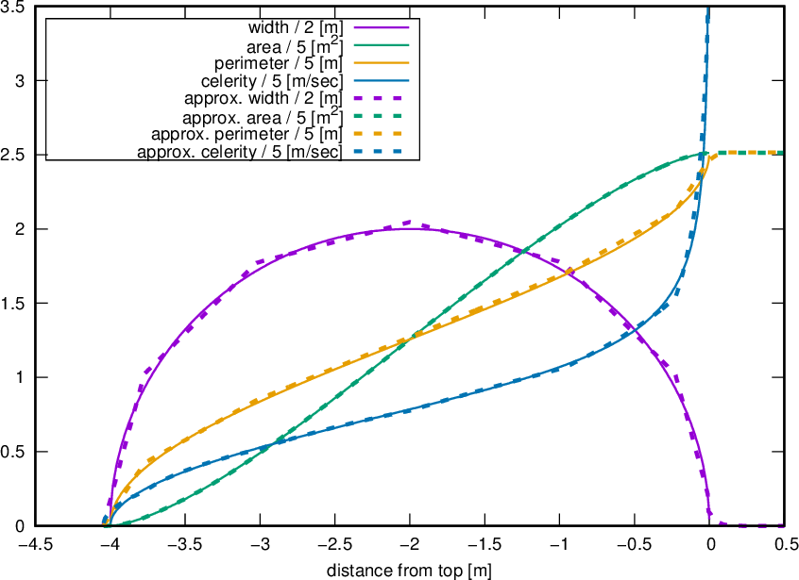
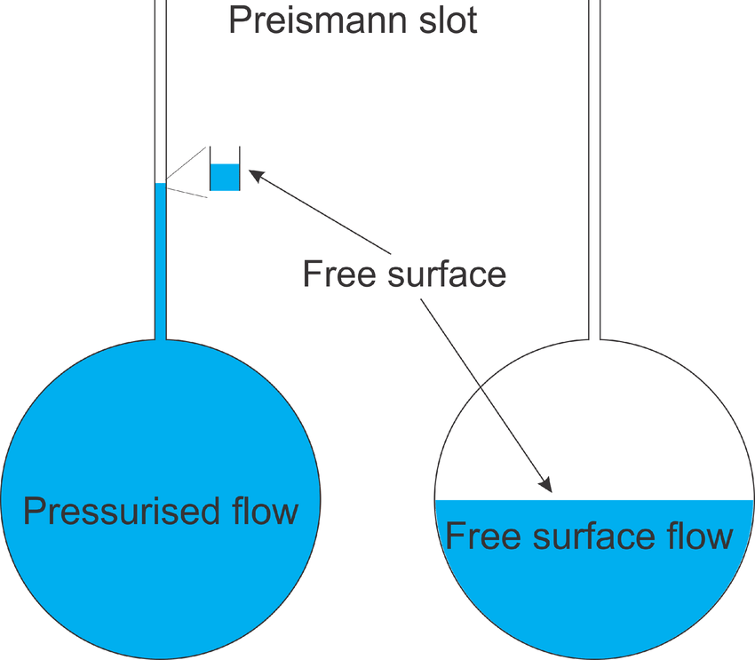
The great man-made river
4m diameter pipes through Libyan desert circular cross section approximated by dodecagon with added Preissmann slot
Preissmann slot
From presentation Michiel Tukker
Free surface flow in Wanda
April 10, 2020
Notes:
Work from 1999-2000
Preissmann slot on top of pipe of approximately exponential shape: at top 0.2m wide, every next 0.05m sqrt(10) smaller, until 0.0002m=0.2m/10^3=0.2mm at distance 0.3m above top
With Preissmann slot of 0.0002m (= 0.2mm) at top (to ensure a free surface in fully filled pipes), max. wave celerity in fully filled pipe is sqrt(g*A/W) = sqrt(9.81*Pi*2^2/0.0002) = 785m/sec. This is pretty close to 1450m/sec, the speed of sound in water. NB, if relevant, the (much) lower speed of sound in water with dissolved air could be easily emulated with a slot of variable, air-concentration-dependent width.
With Preissmann slot of 0.0002m (= 0.2mm) at top, 0.220% additional storage when 110m water in slot (NB, 110m*0.2mm = 0.175% of π*2m*2m).

Slide 22
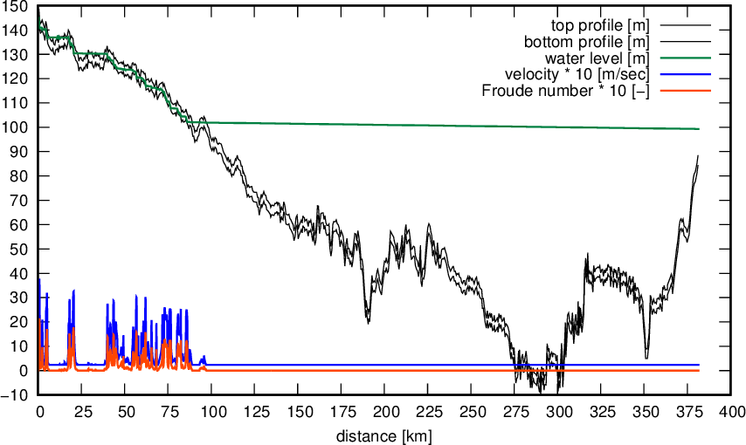
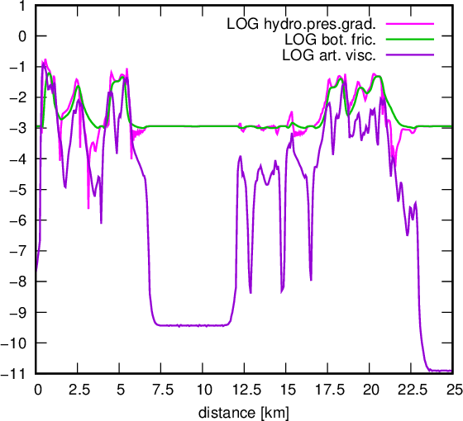
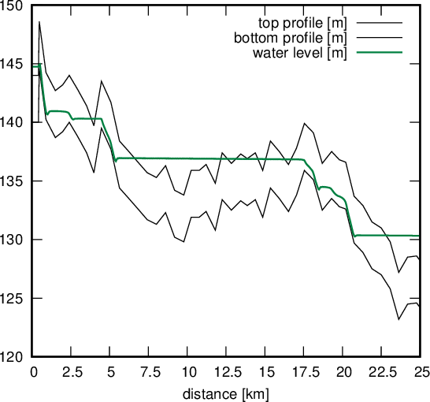
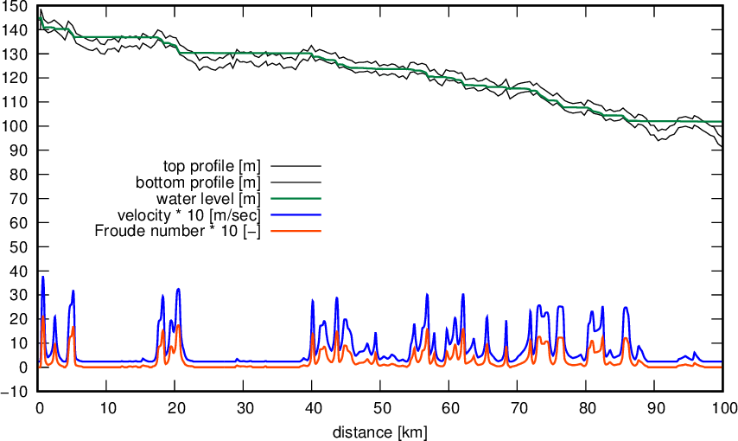
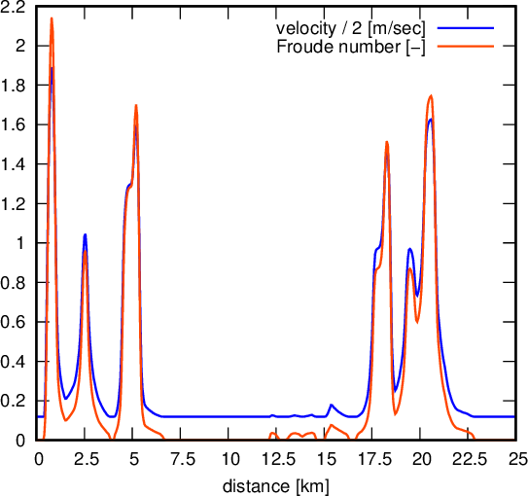
Steady-state great man-made river
381.2km long 4m diameter pipe through Libyan desert
2000 finite volumes: 1815 of 54.96m in first 100km, 165 of 1648.8m in last 270km, 20 in between

Slide 23
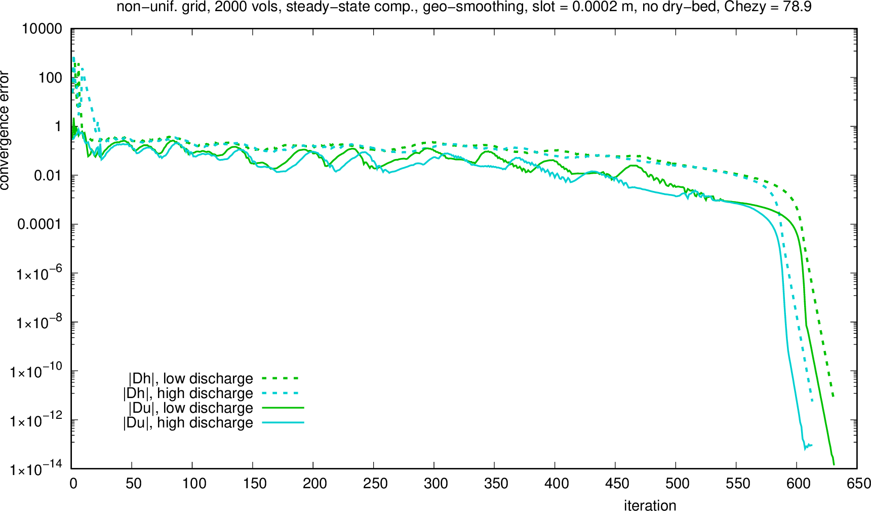
Steady-state great man-made river
2000 finite volumes, convergence history
Notes:
Results from the year 2000.
Steady-state computation, hence 1/Dt_phys = 0 and theta = 1
Initial solution: Q=0m^3/sec, zeta=144m (why water level just a bit too low? Hm!)
Convergence error-dependent pseudo time step used.
High2000ultra.log: 613 iterations, 260.01sec CPUtime (in 2000) (battery-powered notebook with processor at half speed?).
Low2000ultra.log: 631 iterations, 132.15sec CPUtime (in 2000).
Estimation of convergence speed of 1D D-Flow FM for this problem is O(1,000) iterations for factor 10 residue reduction, assuming local time stepping, otherwise much slower due to variation in flow speed and in grid size. In view of its much more work per pseudo time step, SUPSUB would then be not much faster, however, in D-Flow FM nested Newton required to deal with Preissmann slot → (at least) 9 iterations per time step.
Gropp, Keyes, McInnes, Tidriri (2000), “Globalized Newton-Krylov-Schwarz algorithms and software for parallel implicit CFD”, about +- optimized pseudo time stepping and the phases during convergence: “The globalization theory of Kelley and Keyes (1998) employs a three-phase approach, but phases in practice may or may not be cleanly demarcated in residual norm convergence plots. Initially, ||u0 – u*|| ~ 1 and tau0 << 1 (MB: read CFLpseu ~ 1). During an 'induction phase', the solution is marched in a method-of-lines sense with a relatively small time step until ||u – u*|| / ||u0 – u*|| << 1. Success of this phase is governed by stability and accuracy of the integration scheme (we simply use the backward Euler method) and by the choice of initial iterate. For problems in which a complex feature, such as a shock or a flame front, must arise from a structure-free initial condition, the induction phase is typically by far the longest. (We are reminded of an observation attributed to Samarskii: 'The slower you start, the sooner you finish'.) (MB: NICE!) In a grid-sequenced problem, in which the initial iterate on a given fine grid is interpolated from a converged solution on a coarser grid and in which solution features are correctly located (if not fully resolved), the induction phase on the finest grid can be relatively brief (Smooke and Mattheij, 1979). During a second 'transition phase', the time step is built up in the neighborhood of the solution. The critical assumption is existence of a beta such that ||(I + tau f'(u))^-1|| <= (1 + beta tau)^-1 for all tau >= 0 if ||u – u*|| <= eps. Finally comes a 'polishing phase', during which the time steps approach infinity (or some user-imposed upper bound), and iterates approach the root with asymptotic Newton-like convergence. This phase is treated by a conventional local analysis, as in Kelley (1995)."

Slide 24
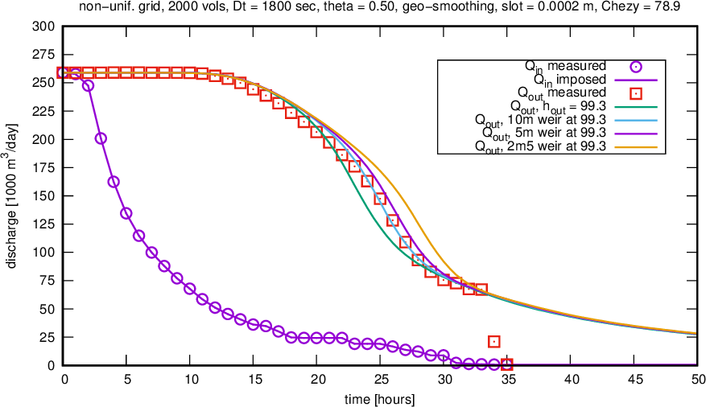
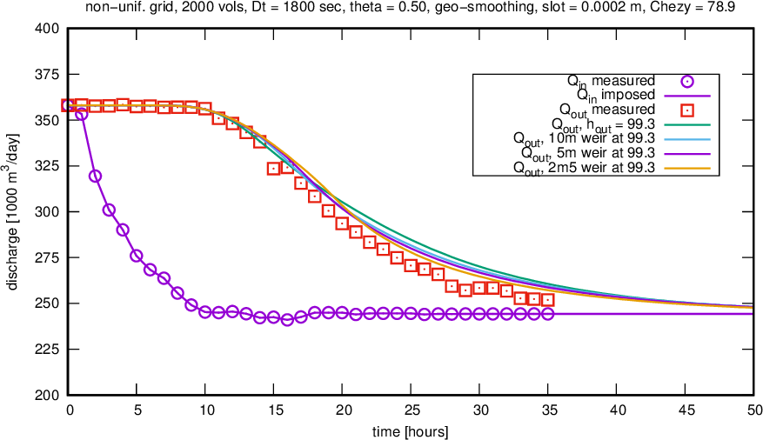
Unsteady great man-made river
Comparison with measurements, low discharge
high discharge
Notes:
Results from the year 2000.
Time step is 1800 sec. Anton Heinsbroek: simulations with SOBEK(-URBAN?) (version of 20 years ago?) required time steps of 1/4 sec.
Low2000ultra.logunst: average number of iterations per time step is (14659-10681)/100 – 3 extra lines = 36.78. Total CPU time: 1262.30sec (in 2000).
High2000ultra.logunst: average number of iterations per time step is (14257-10681)/100 – 3 extra lines = 32.76. Total CPU time: 1142.12sec (in 2000).
Low2000ultra_copy&uconverrorLT1E-8.logunst: average number of iterations per time step is (13494-10681)/100 – 3 extra lines = 25.13.
High2000ultra_copy&uconverrorLT1E-8.logunst: average number of iterations per time step is (13142-10681)/100 – 3 extra lines = 21.61.
Hence for low (high) discharge scenario on average 37 (33) iterations required per time step with convergence criterion of 1.E-11. With convergence criterion of 1.E-8 (in practice probably more than enough) on average 25 (22) iterations required per time step.
NB, max. CFL number based on max. wave speed 785.1m/s and smallest grid size 56.96m is nearly 26000. Max. Courant number based on max. flow speed 3.78m/sec is nearly 125.

Slide 25
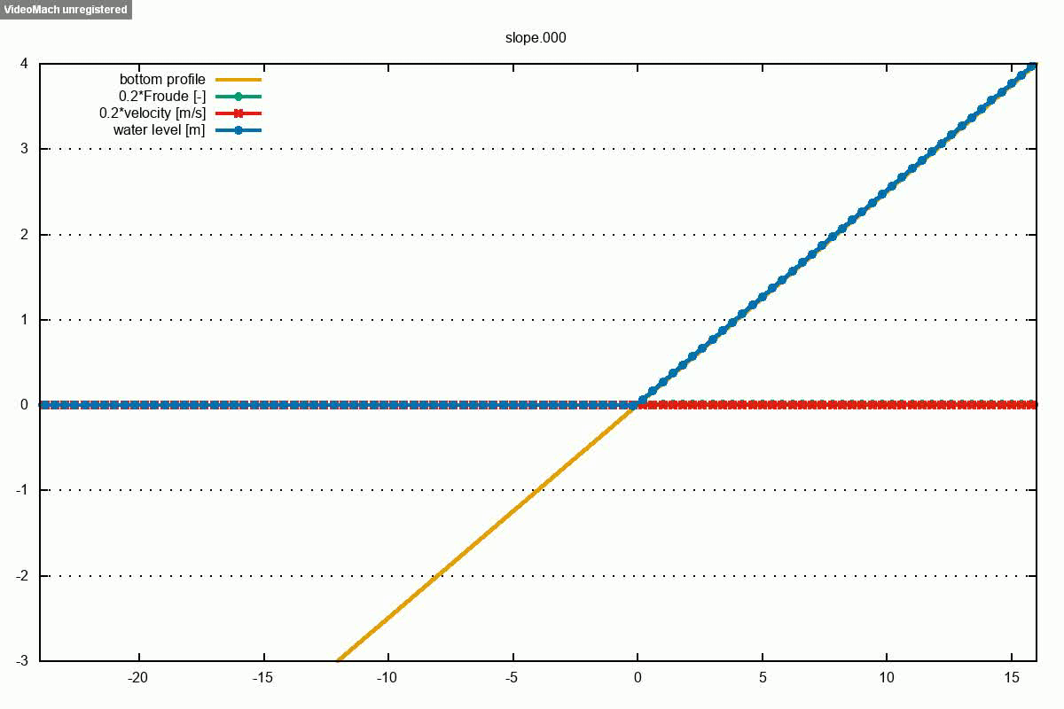
Wave run-up/run-down
9─17 iterations per time step
(12.3 on average)
→ better initial solutions required to
speed up convergence per time step
Notes:
Result from 2002; max.Froude number at time step 432 is nearly 18.
Largest (negative) velocity is about -7.5 → Cour_max = |u_max|*Dt/Dx = 1.75
Chezy=100, domain length=40, Dx=0.4, 500 time steps, Dt=0.1, theta=0.6, convergence criterion |Dh|, |Du| < 1.E-8
_slope.log: iteration process from line 382 to line 8057, hence average number of iterations per time step is (8057-382)/500 – 3 extra lines = 12.35. Total CPU time: 17.03sec (in 2002). MB, number of iterations varies from 9-10 to 17.
2019-05-05: drying and flooding procedure used in SUPSUB consists of turning off hydrostatic pressure gradient g*h*GRAD(zeta), i.e., the driving force, when water depth (and flow velocity) become very small → small layer of water remains. This can be obtained by adding to rhs something like g*h*GRAD(z_b)*(eps_h/(h+eps_h))^p or g*h*GRAD(z_b)*exp((-h/eps_h)^p), with eps_h dry-bed threshold and p some power. Also required: change bed-friction term -q*|q|/(C^2*h) to something like -q*(q^p+eps_q^p)^(1/p)/(C^2*h), with p even, which at the same time regularizes this term.

Slide 26
Summarizing …
Properties of space discretization:
Smoothing errors dominant, discretization errors negligible → numerical errors can be interpreted physically! → numerical errors can be compared to physical errors!
Pretty accurate
Continuous and smooth
very fast solvers
robust model
(block-)Structured grids required
flexibility by means of DD and IBM
Time integration:
To be investigated

Slide 27
Motto
SUPPRESS THE WIGGLES, BUT SUCH THAT
THEY KEEP TELLING YOU SOMETHING!
(variation on Gresho & Lee, “Don’t suppress the wiggles—They’re telling you something!”, Comput. Fluids 1981)
Notes:
Gresho & Lee, 1981: “It is further argued that it is usually an inappropriate response to develop methods which a priori suppress these wiggles and thereby make claims that these unconventional FEM techniques (MB: or any other wiggle-suppressing technique, for that matter) are actually improvements and can be used to solve difficult problems on coarse meshes.”

Slide 28
What’s next
SUPSUB next version:
embed as single-pipe component in WANDA?
better initialization per time step (unsteady applications) → increase of robustness and efficiency
better pseudo time-step scaling (based on residual and full linearization error) → increase of robustness and efficiency
proper geometry smoothing (boundary/initial condition smoothing p.m.) → some increase of accuracy, robustness, efficiency
moving error-minimizing grid adaptation (p.m.) → large increase of accuracy, efficiency, complexity
Wave modeling (Boussinesq-type, multi-layer, GABCs):
extension to 2DV, IMEX time integration?
2DH/3D with DD and IBM for modeling flexibility (p.m.)
Notes:
Increase of robustness → increase of general applicability
* include missing functionality/features (geometry types, friction formulations, 2-phase flow?)
* embed as single-pipe component in WANDA (computational model for pipe networks)

Slide 29

Remarks, discussion, questions?

Slide 30
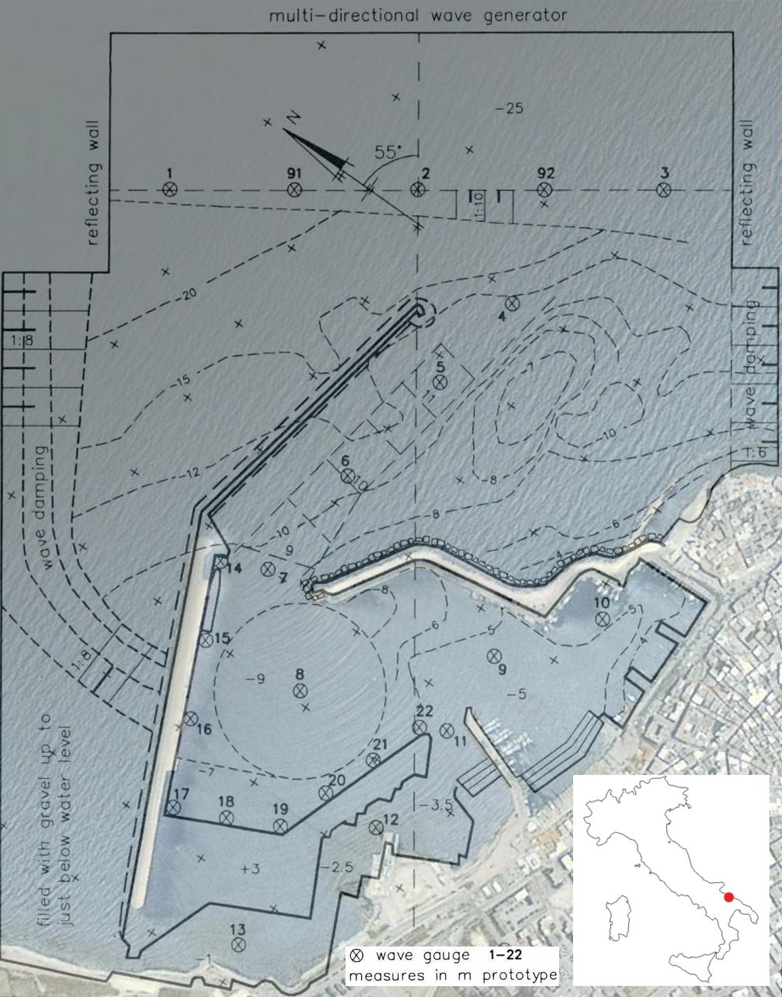
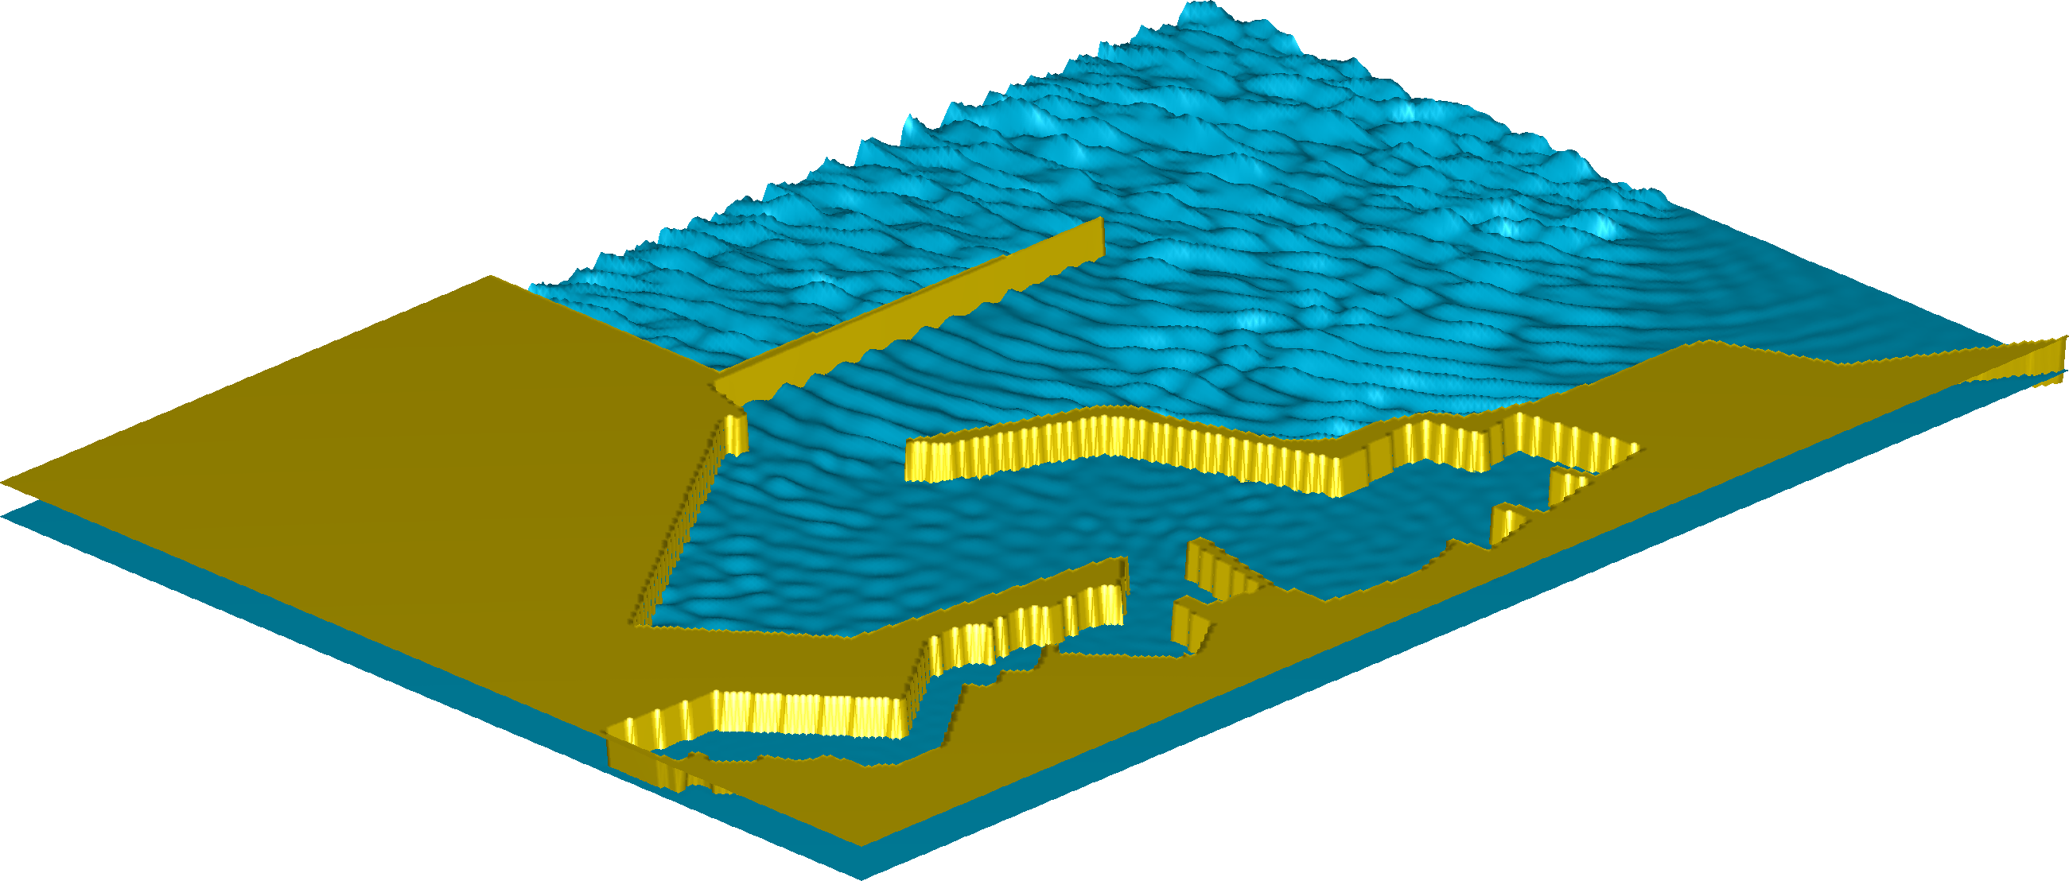
A wave modeling example
25 m
Port of Molfetta, Italy
11 m
10 m
8 m
Notes:
port extension scale-model project (90-ies), plans never finalised/constructed
wave spectrum (T_{p} = 6.9 s, H_{s} = 2.3 m)
dir spreading
bound (‘setdown’) and free LF waves
limited spurious free waves expected
locations relevant for vessels (depth >= 8 m)

Slide 31
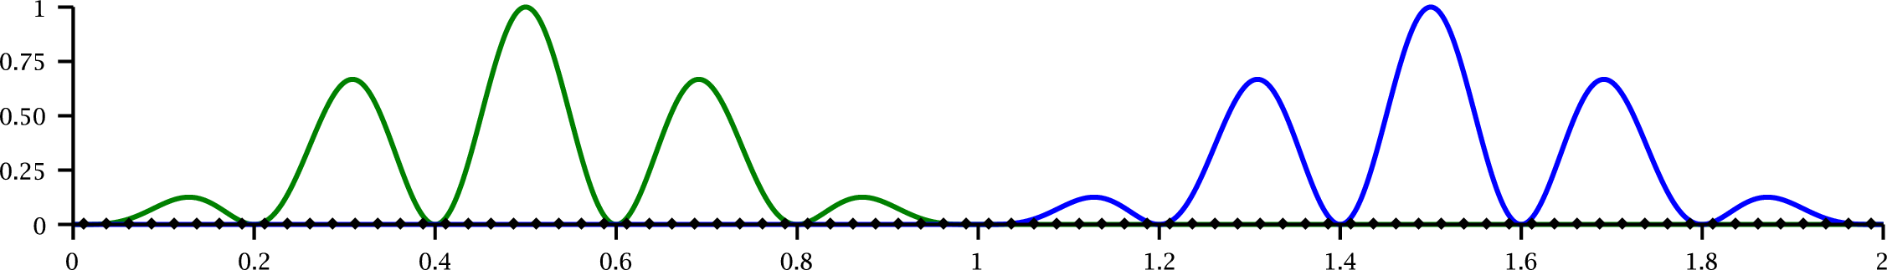
Performance of several space discretizations
Transport of wavy signal
initial solution
final solution

Slide 32
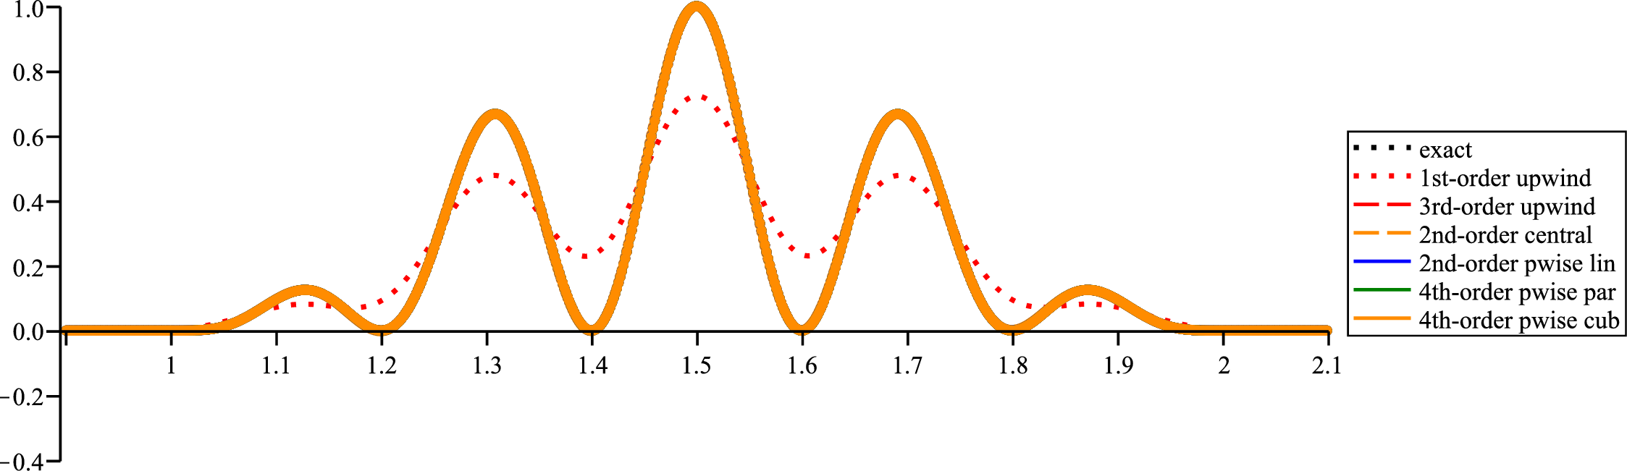
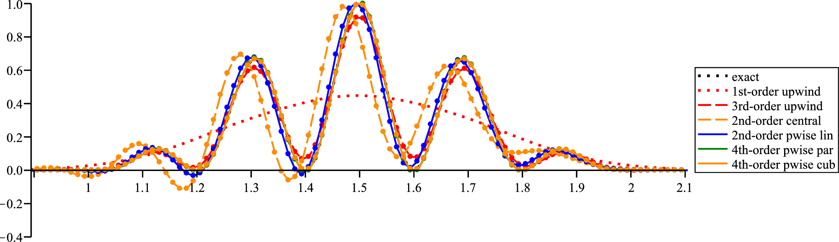
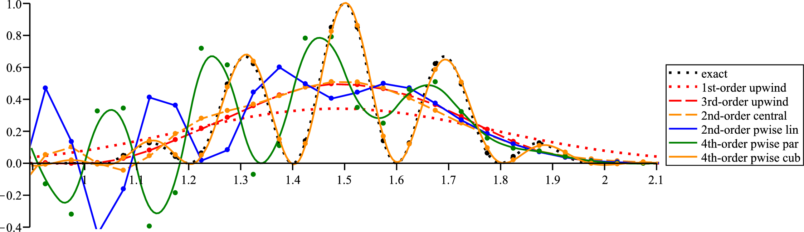
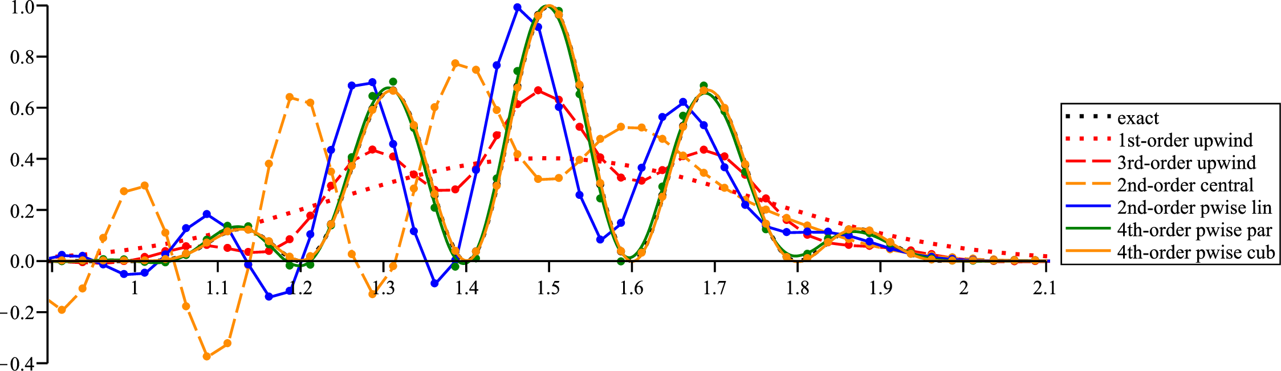


Performance of several space discretizations
Transport of wavy signal
320 finite volumes (Δx=0.003125)
20 finite volumes (Δx=0.05)
40 finite volumes (Δx=0.025)
80 finite volumes (Δx=0.0125)
640 finite volumes (Δx=0.0015625)
160 finite volumes (Δx=0.00625)

Slide 33



Performance of several space discretizations
Transport of wavy signal
33
Notes:
NASA Vision 2030 CFD Code, Vision of CFD in 2030:
Emphasis on physics-based, predictive modeling
Management of errors and uncertainties
A much higher degree of automation in all steps of the analysis process
Ability to effectively utilize massively parallel, heterogeneous, and fault-tolerant HPC architectures that will be available in the 2030 time frame
Flexible use of HPC systems
Seamless integration with multi-disciplinary analyses
From [Kroll.Leicht.ea_2015]: “The main objective of the ADIGMA project (2006-2009) was the development of innovative high-order methods for the compressible flow equations in combination with reliable adaptive solution strategies, enabling mesh independent numerical simulations for aerodynamic applications. The project concentrated on technologies showing the highest potential for efficient high-order discretization on unstructured meshes, namely the Discontinuous Galerkin (DG) methods and the Continuous Residual Distribution (CRD) schemes. Although significant progress has been made in ADIGMA, it was finally concluded that many of the achievements in high-order simulation methods are still far away from industrial maturity.”

Slide 34

Performance of several space discretizations
Transport of block with cosine slopes
initial solution
final solution

Slide 35



Performance of several space discretizations
Transport of block with cosine slopes
35

Slide 36


Fourier-mode decompositions
Block with cosine slopes
Wavy signal

Slide 37


Some more wave modeling examples
Ship-induced waves in a river section Wind waves in a river section

Slide 38




Sub-/supercritical steady flow over a weir
100 finite volumes, adaptive grid
100 finite volumes, uniform grid
100 finite volumes, uniform and adaptive grid, solution around jump
100 finite volumes, uniform and adaptive grid, solution near weir corner
Notes:
Grid size on uniform grid is 5m. Grid size on adapted grid:
at x = 0.0 largest Dx = 74.38m = 14.876 * 5m = 10^1.1725 * 5m
at x = 439.1 smallest Dx = 0.05960m = 0.01192 * 5m = 10^−1.924 * 5m
at x = 194.35 largest stretching of 0.567697 = 1/1.761503 = 10^-0.2459 = e^-0.5662
at x = 438.56 largest stretching of 0.562935 = 1/1.776404 = 10^-0.2495 = e^-0.5746
at x = 439.66 largest stretching of 1.768792 = 1/0.565358 = 10^0.2477 = e^0.5703

